Slide 1
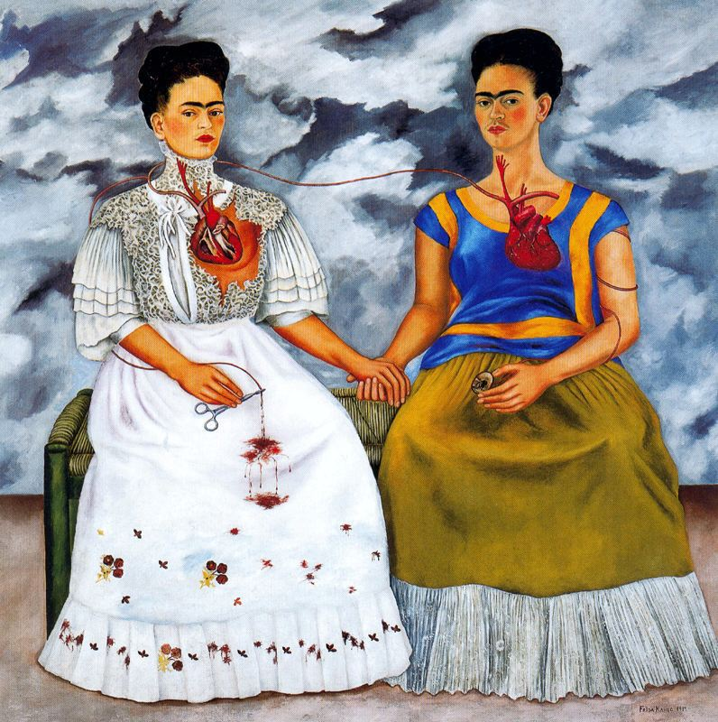

The Two Fridas
1939

Slide 2
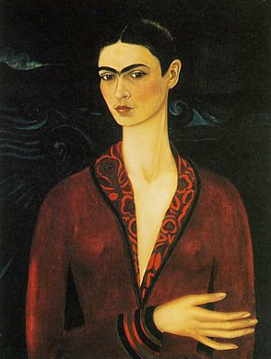
First Self Portrait
Self Portrait in a Velvet Dress
1926

Slide 3
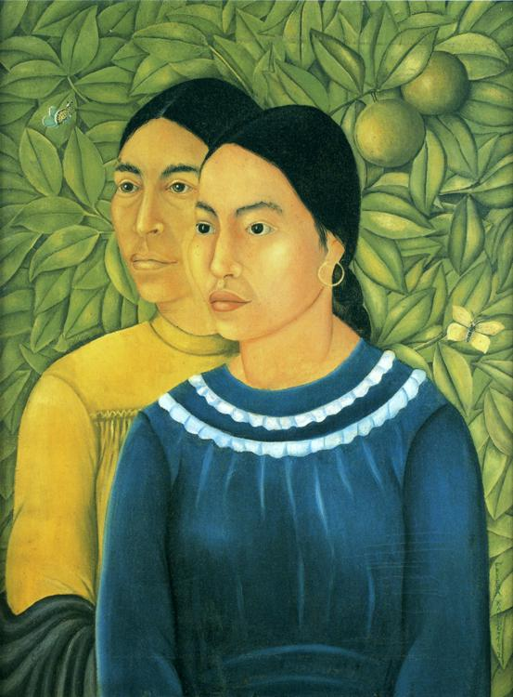
Two Women
1929

Slide 4
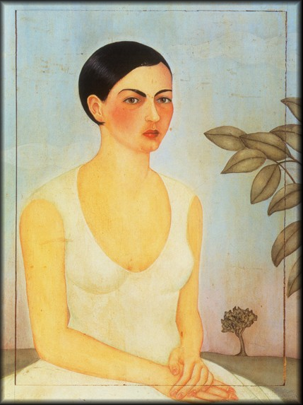
Portrait of my Sister Christina
1928

Slide 5
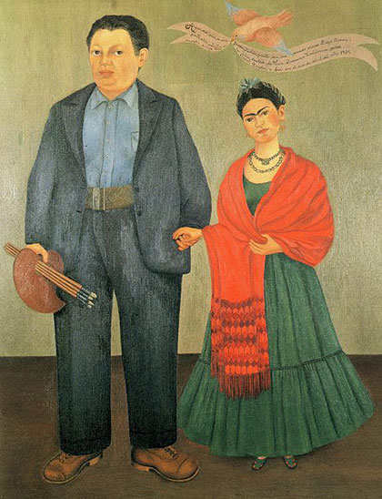
Frieda and Diego Rivera
1931

Slide 6
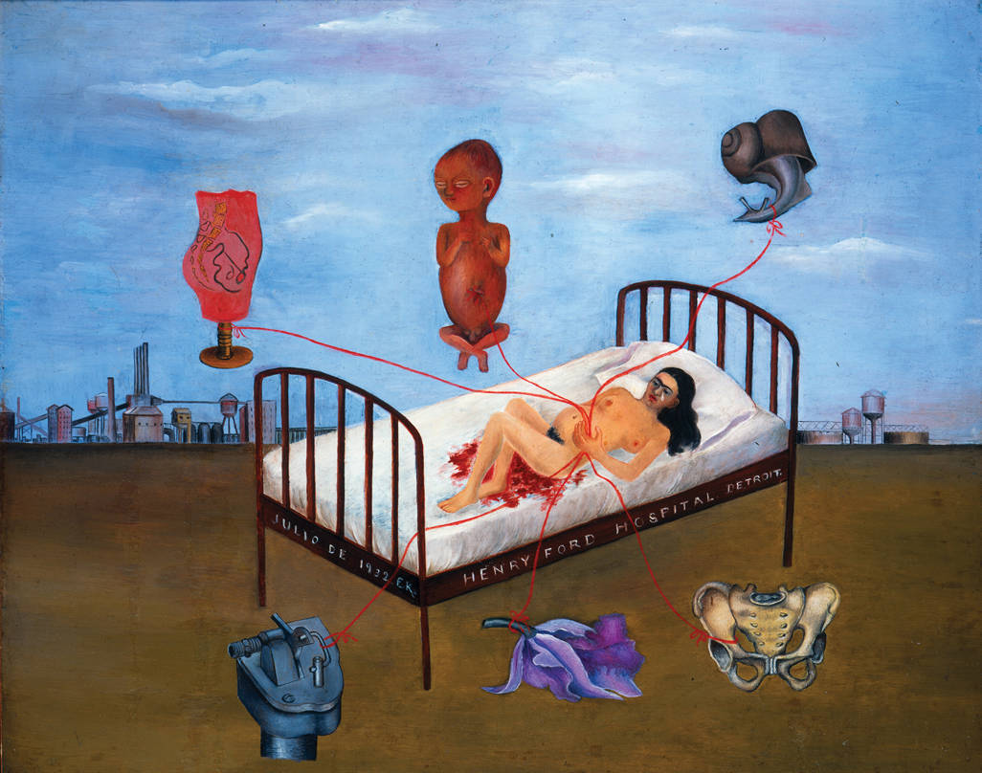
Henry Ford Hospital
1932

Slide 7
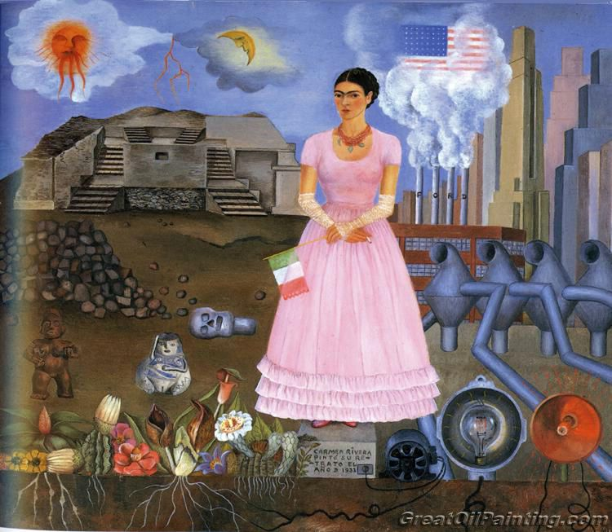
Self Portrait on the Border of Mexico and the United States
1932

Slide 8
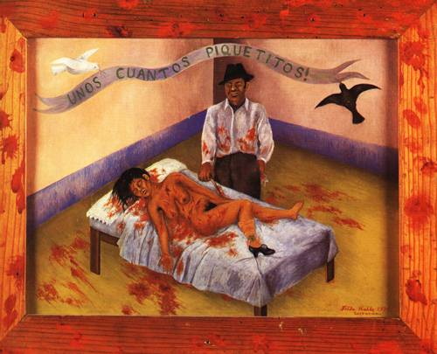
A Few Small Nips
1935
Frida painted her sorrow and anger over the affair her husband Diego was having with her sister Cristina.

Slide 9
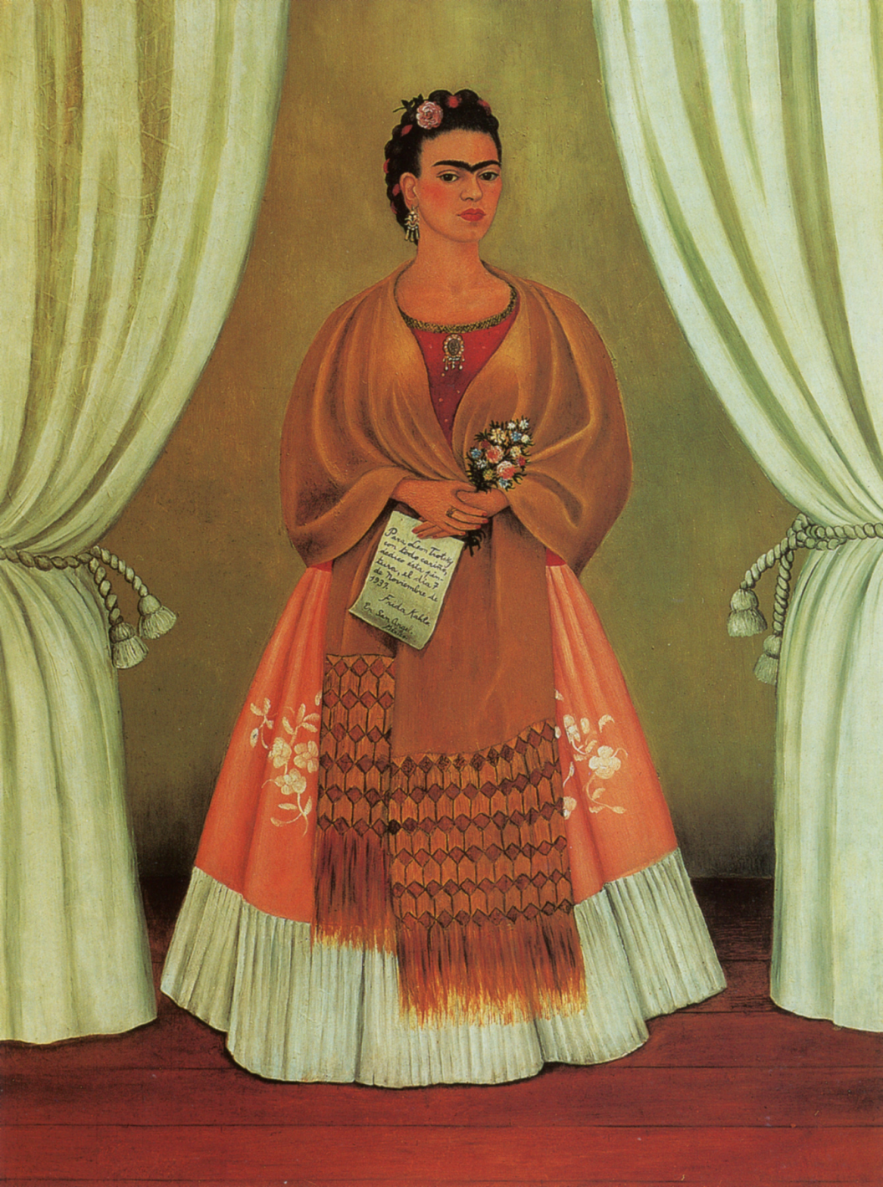
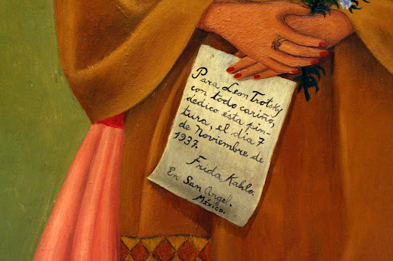
Self Portrait Dedicated to Leon Trotsky
1937

Slide 10
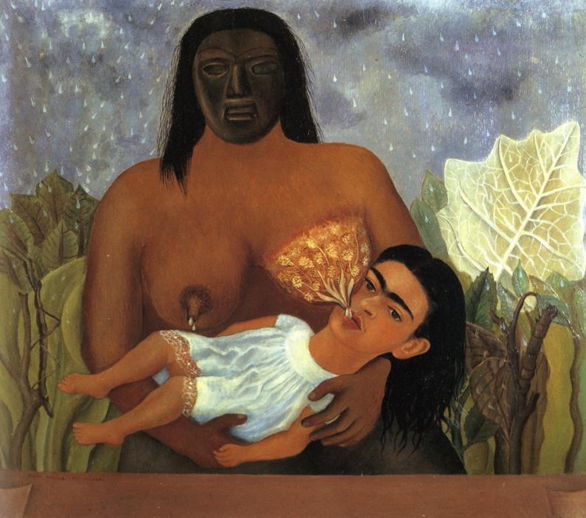
My Nurse and I
1937

Slide 11
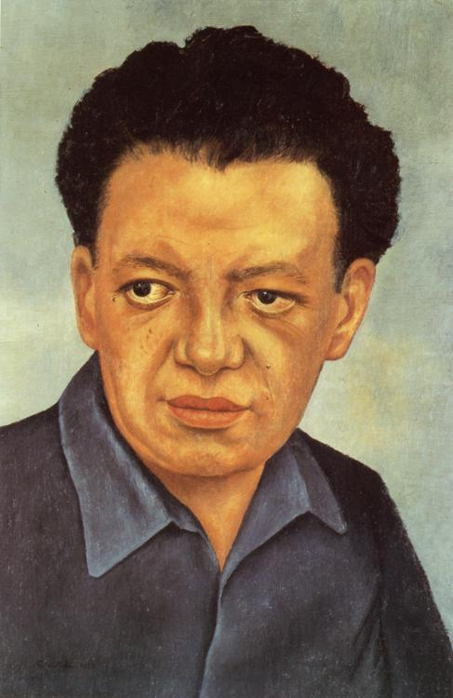
Portrait of Diego Rivera
1937

Slide 12
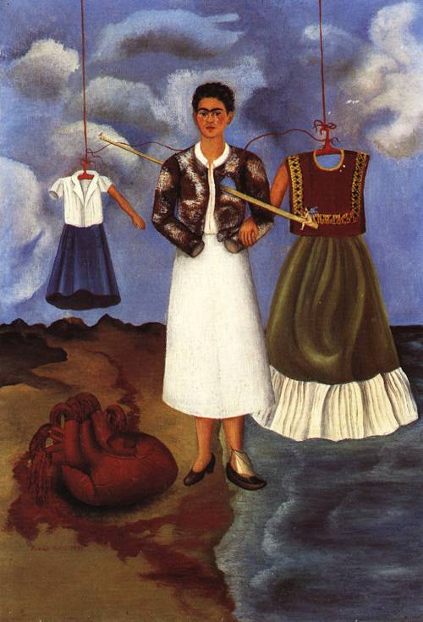
Memory
1937

Slide 13
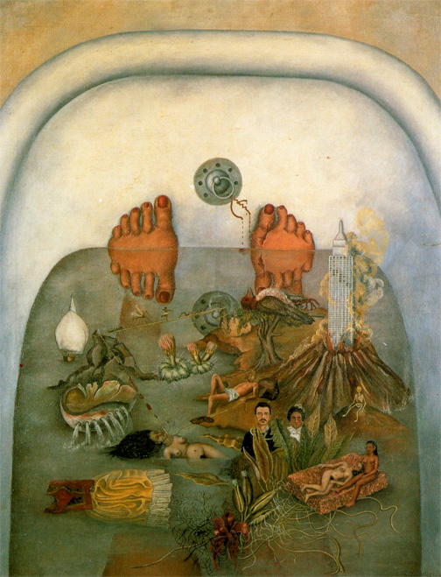
What the Water Gave Me
1938

Slide 14
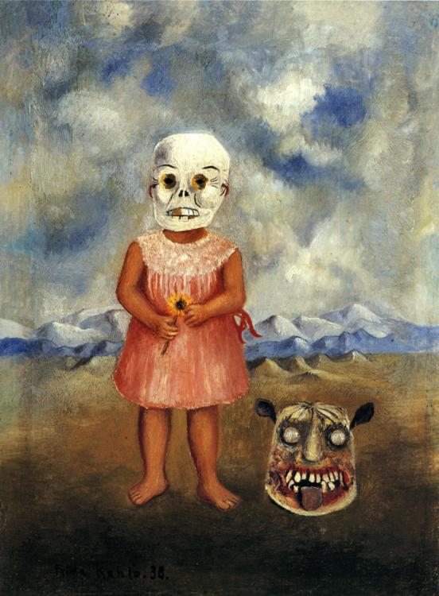
Girl with Death Mask
1938

Slide 15
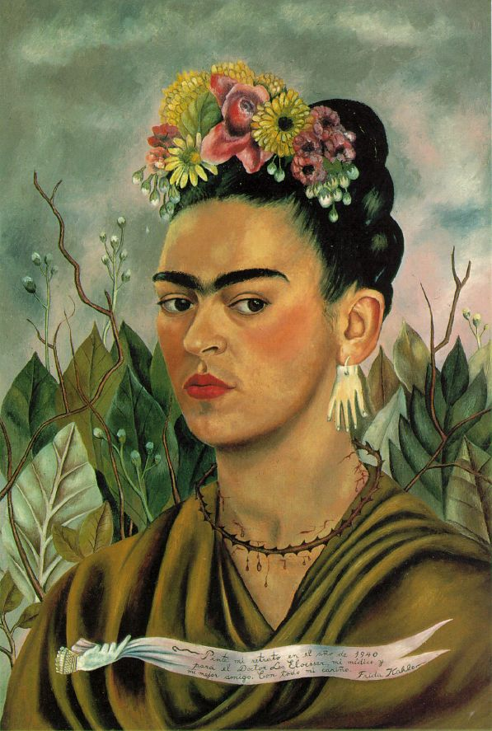
Self Portrait Dedicated to Dr. Eloesser
1940

Slide 16
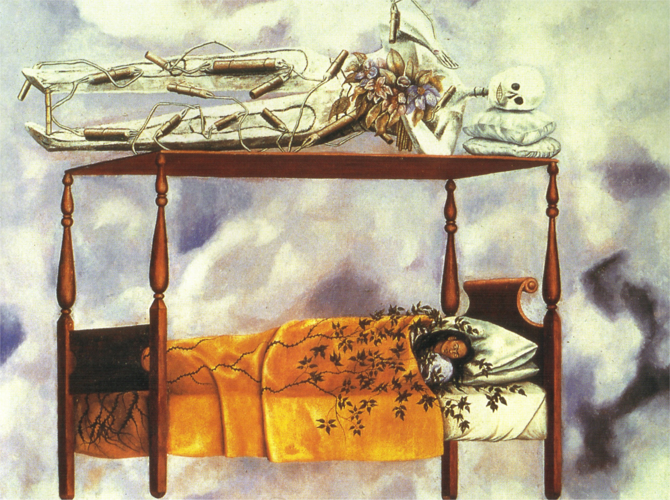
The Dream (The Bed)
1940

Slide 17
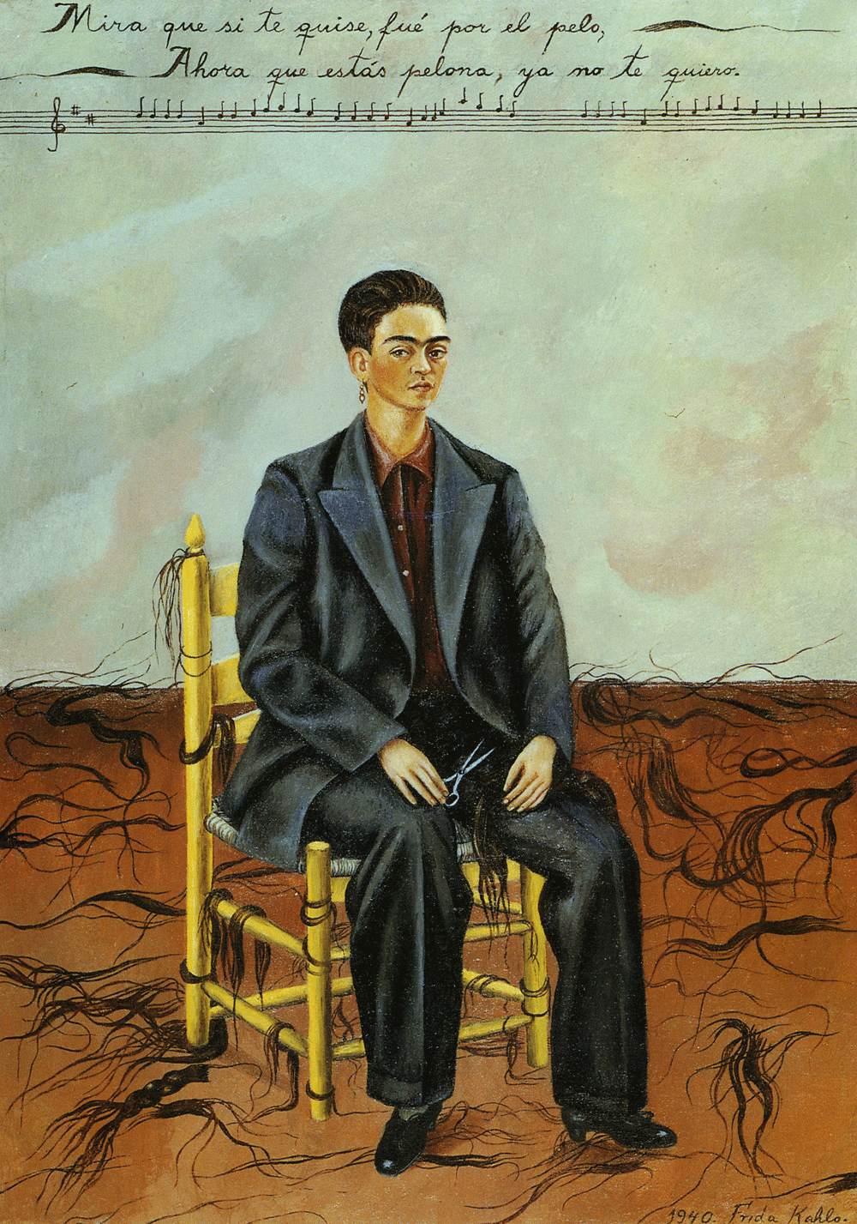
Self Portrait with Cropped Hair
1940

Slide 18
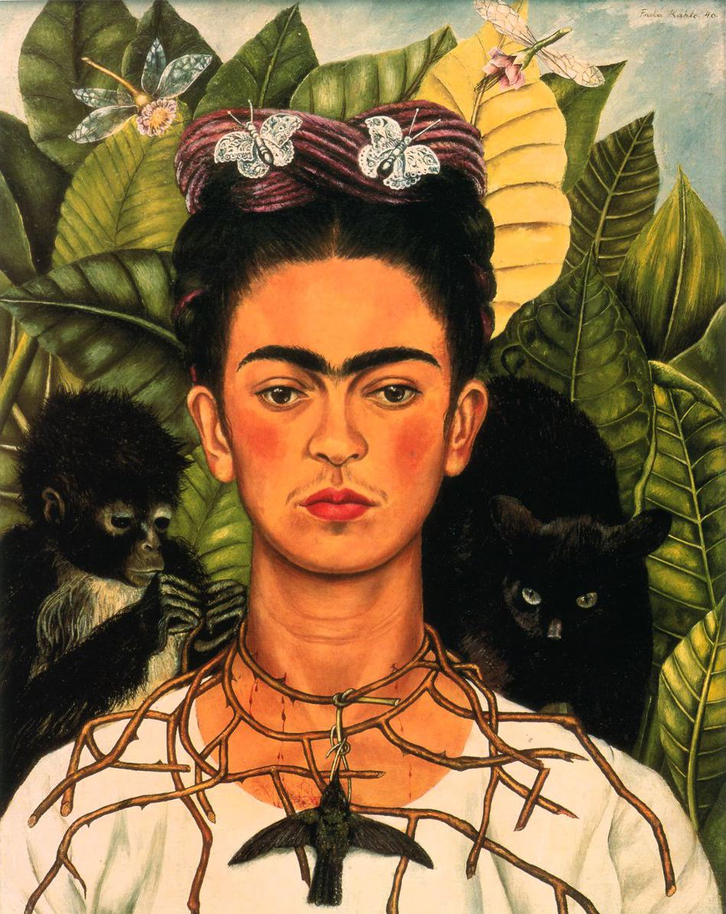
Self Portrait with Thorn Necklace
1940

Slide 19
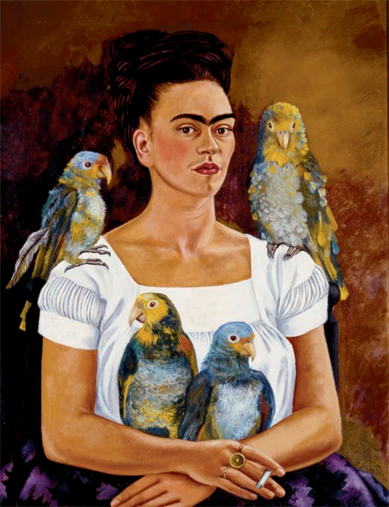
Me and My Parrots
1941

Slide 20
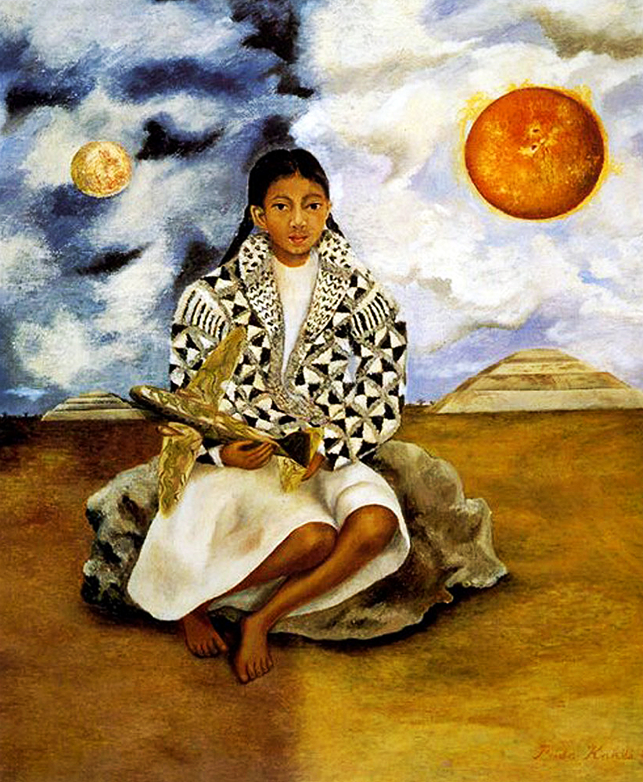
Portrait of Lucha Maria, a Girl from Tehuacan
1942

Slide 21
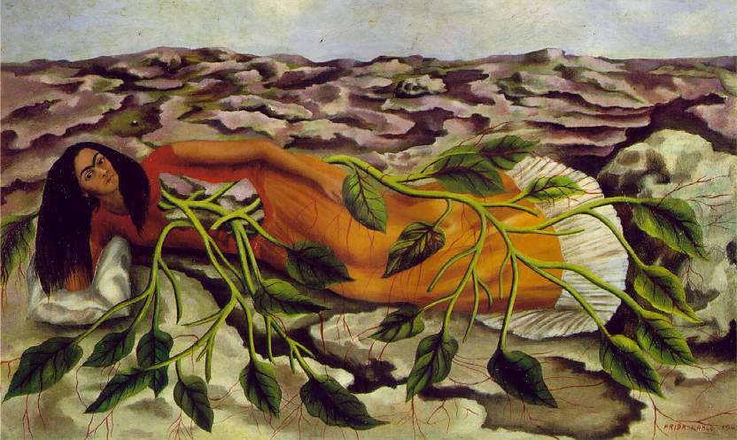
Roots
1943

Slide 22
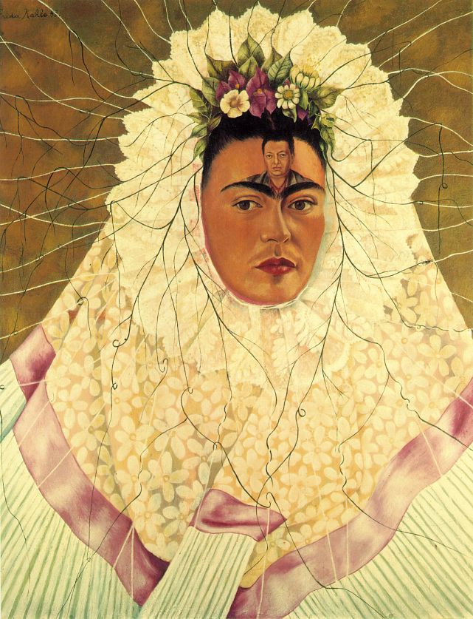
Diego in My Thoughts
1943

Slide 23
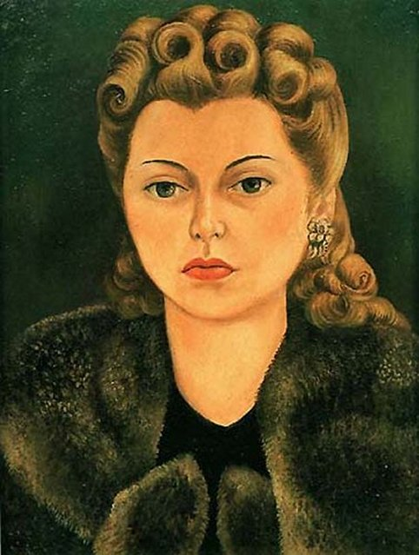
Portrait of Natasha Gelman
1943

Slide 24
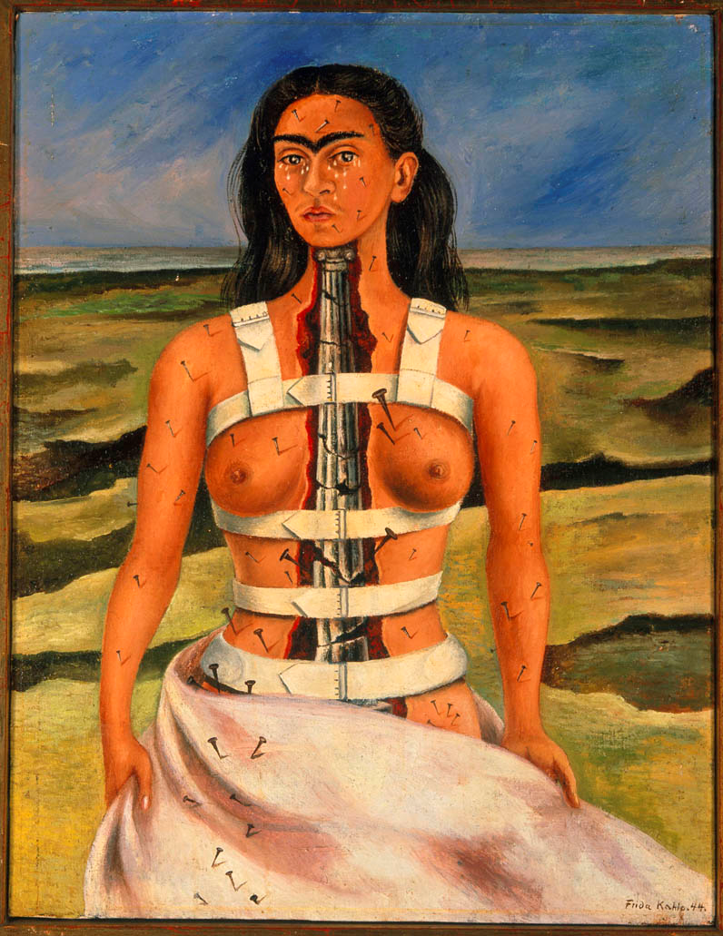
The Broken Column
1944

Slide 25
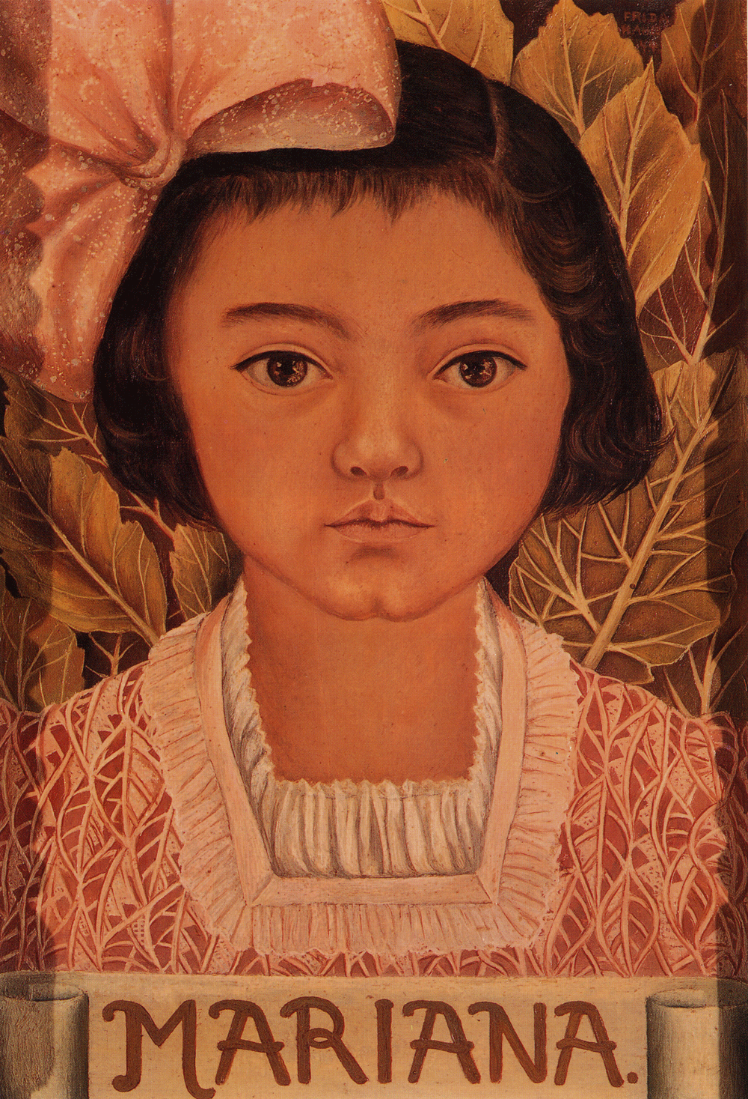
Portrait of Mariana Morillo Safa
1944

Slide 26
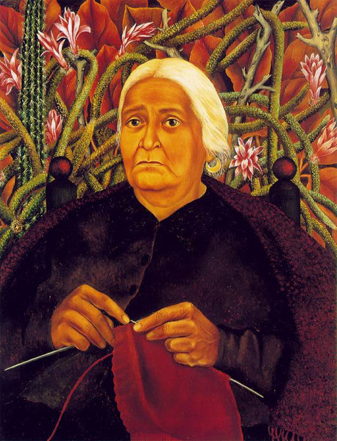
Portrait of Dona Rosita Morillo
1944

Slide 27
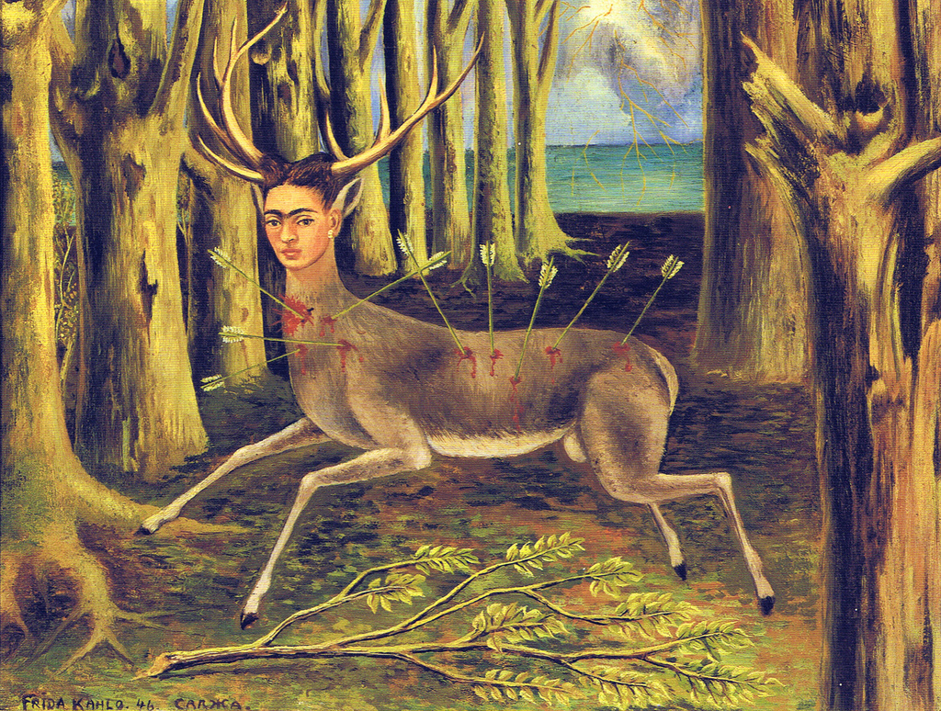
The Wounded Deer
1946

Slide 28
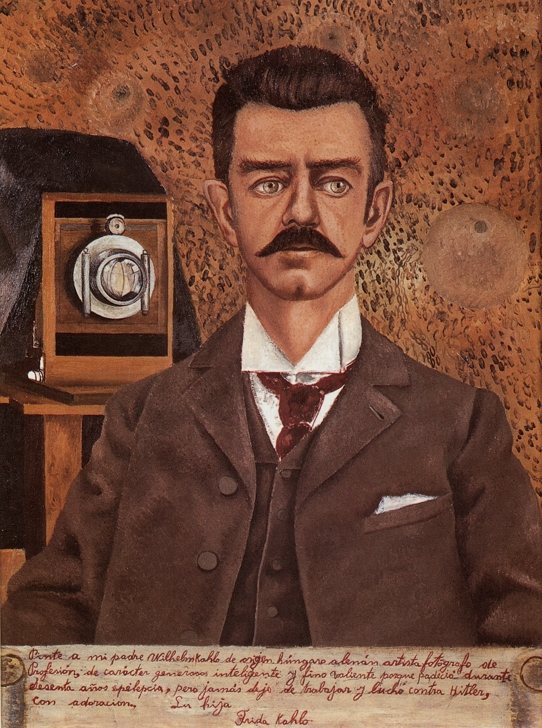
Portrait of My Father
1951

Slide 29
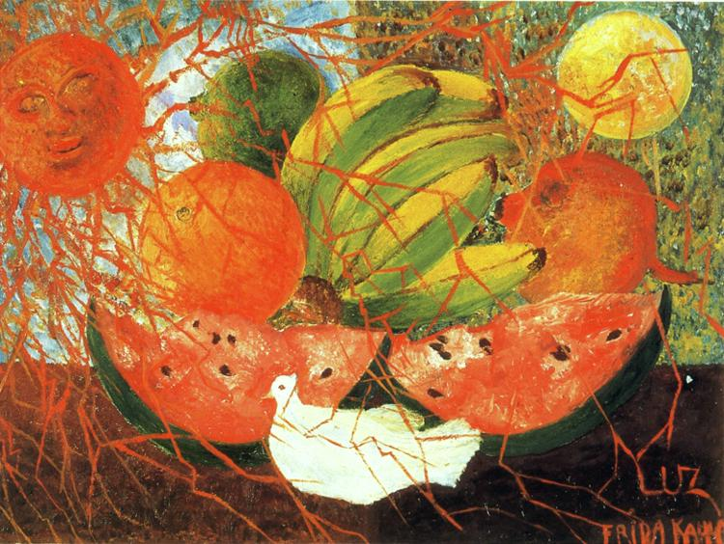
Fruit of Life
1953

Slide 30
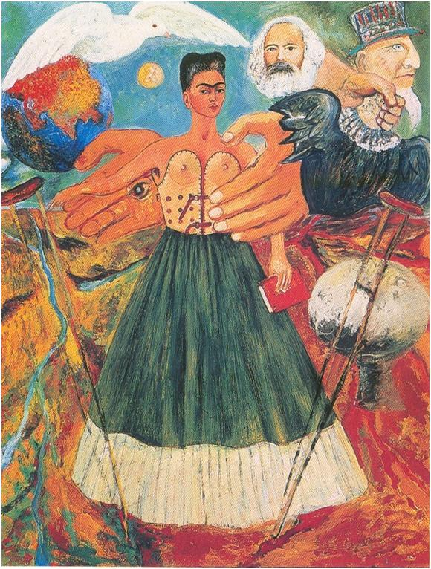
Marxism Will Give Health to the Sick
1954

Slide 31
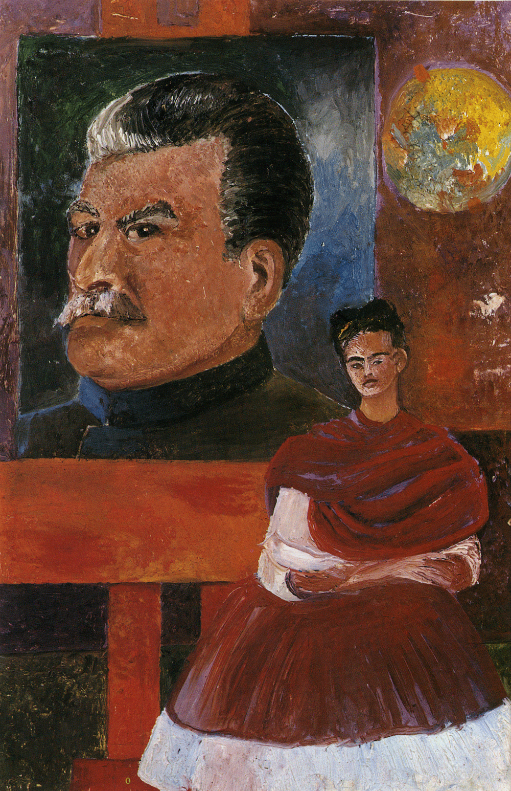
When Frida died in 1954, she left an unfinished portrait in her studio of herself and Stalin.

