Slide 1
MEXICO

Slide 2
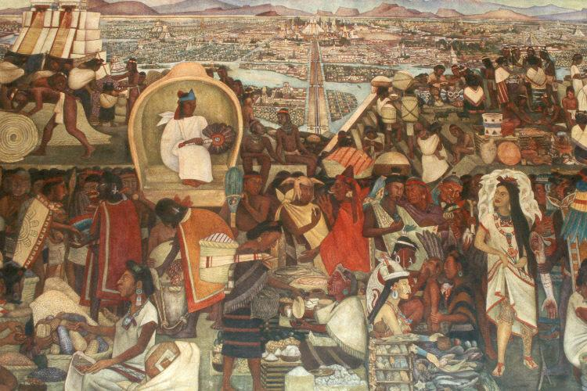
Tenochitlan

Slide 3
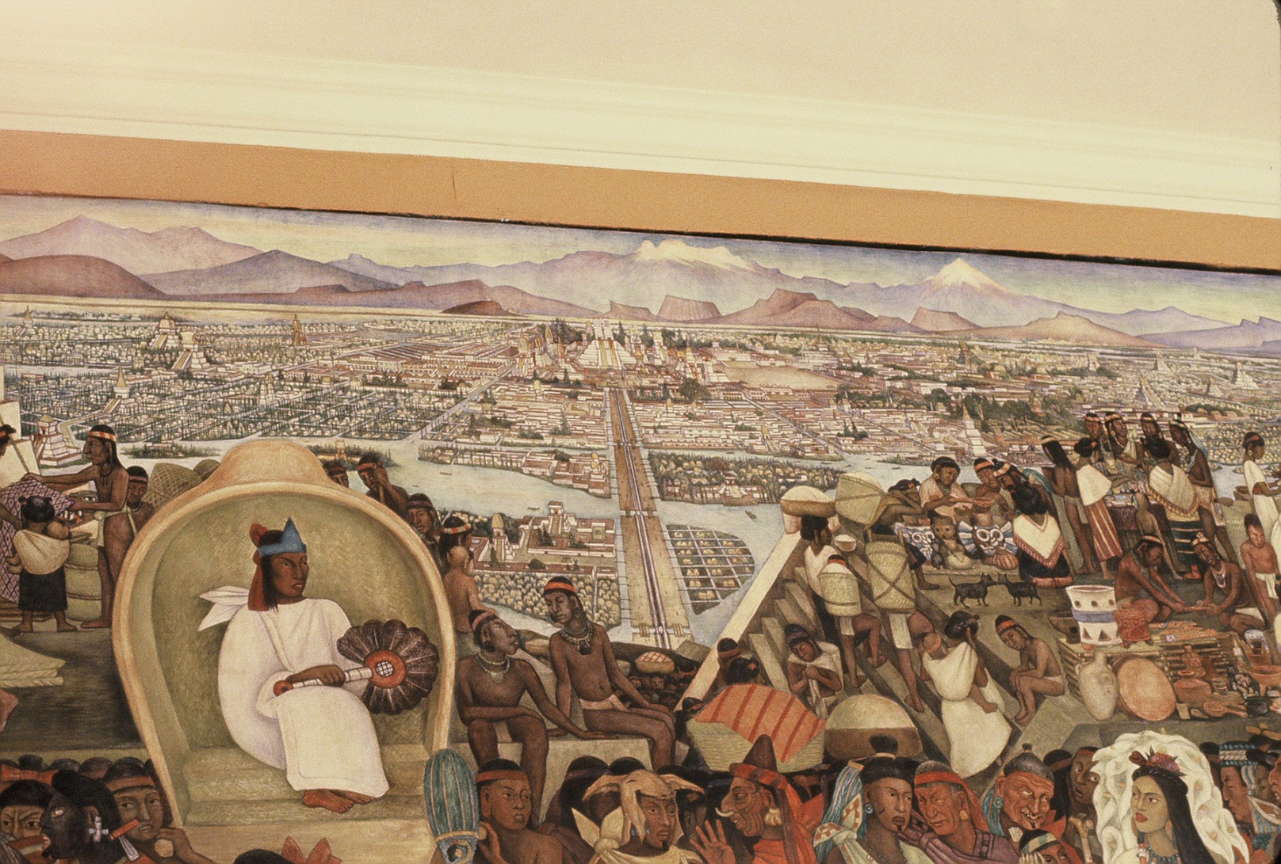
Tenochitlan

Slide 4
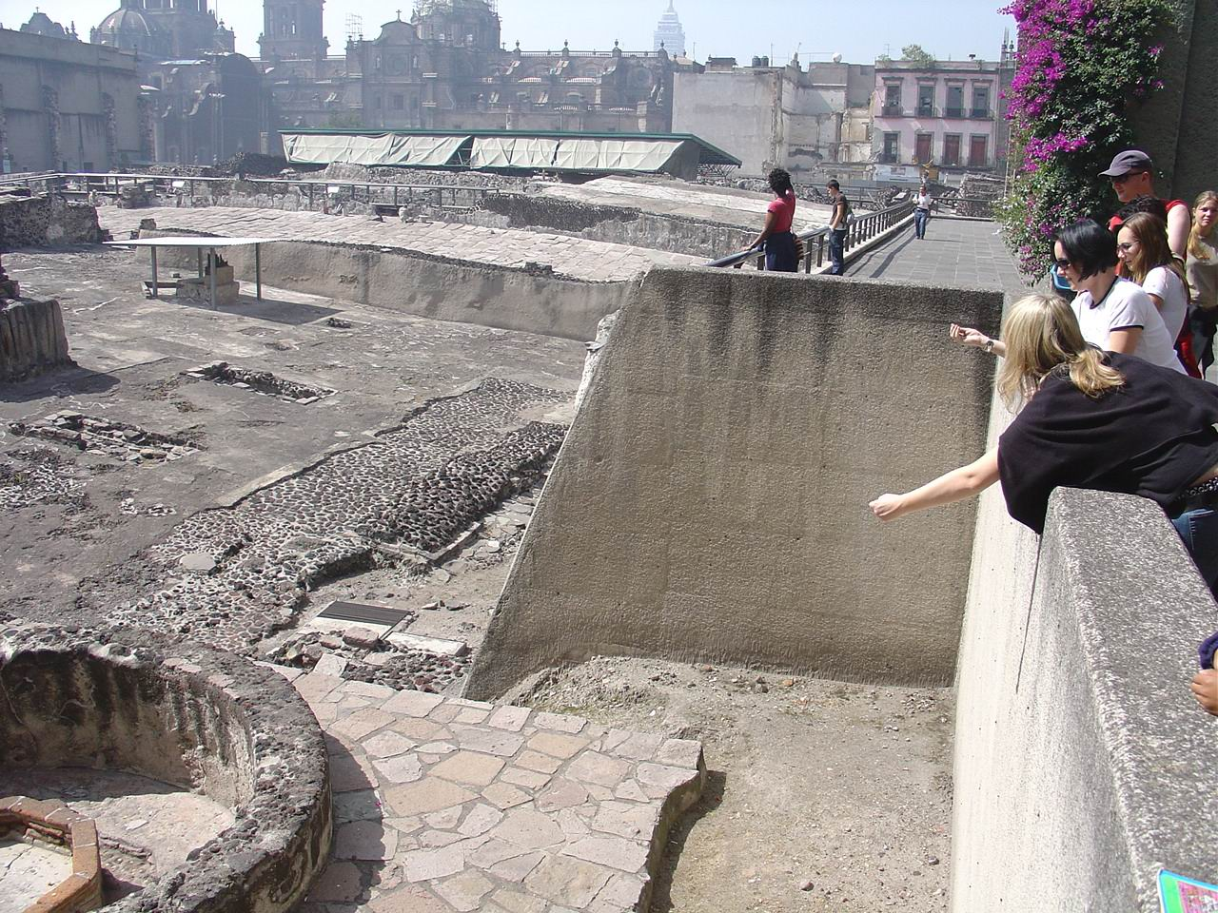
Tenochitlan, Templo Mayor

Slide 5
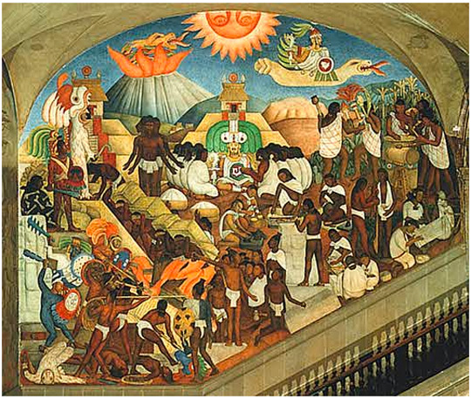
Quetzalcoatl

Slide 6
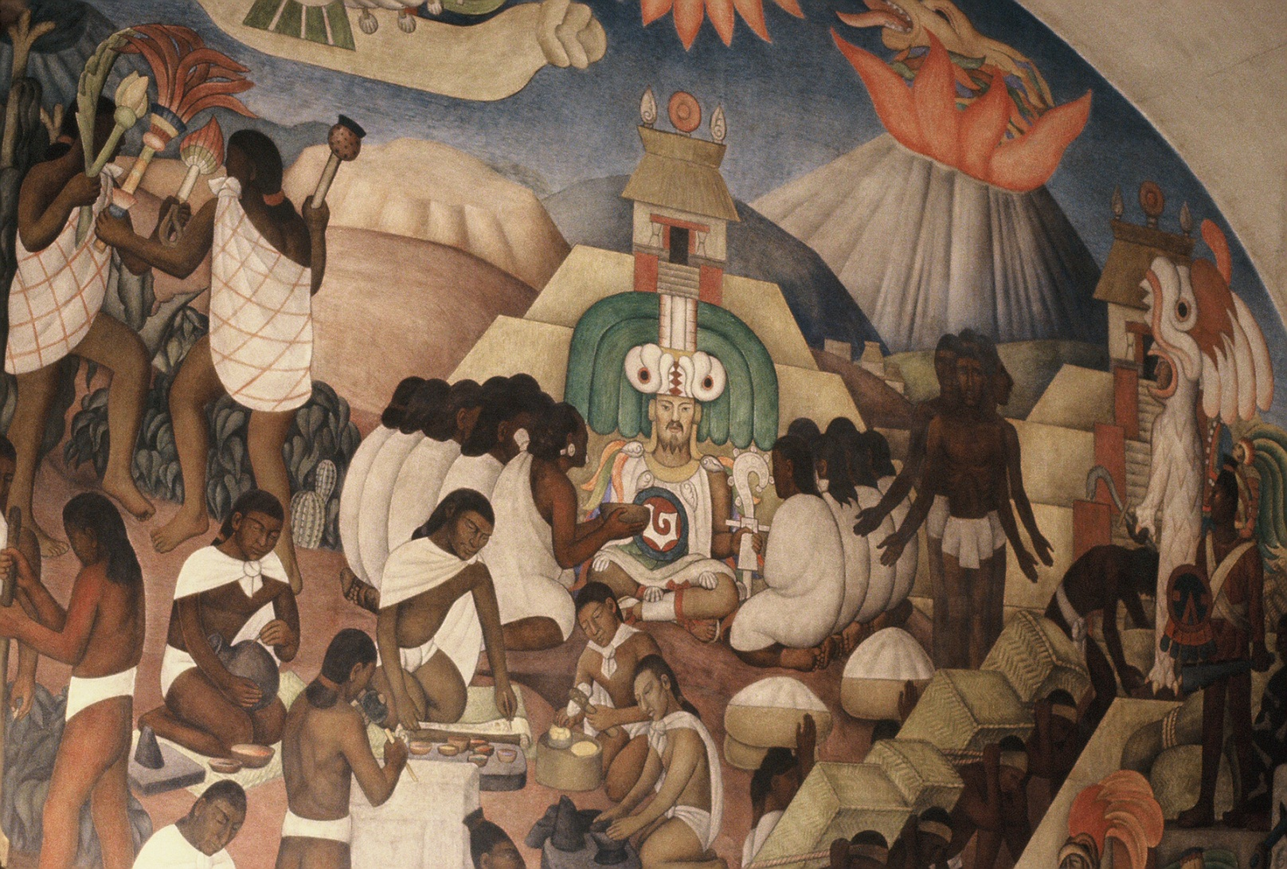
Quetzalcoatl

Slide 7
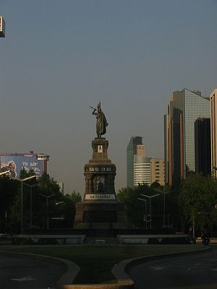
Cuauhtemoc

Slide 8
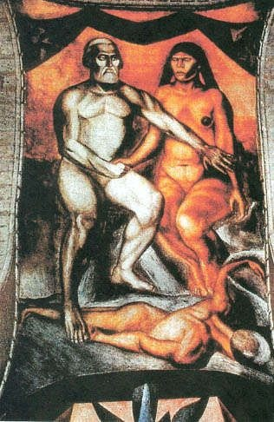
Malinche by Orozco

Slide 9
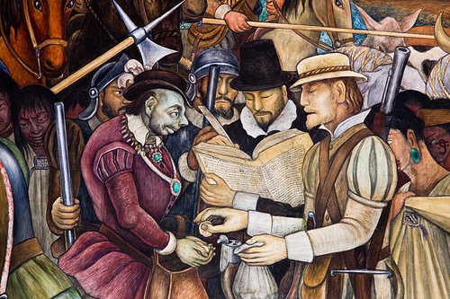
Diego Rivera depicting Spanish Colonizers

Slide 10
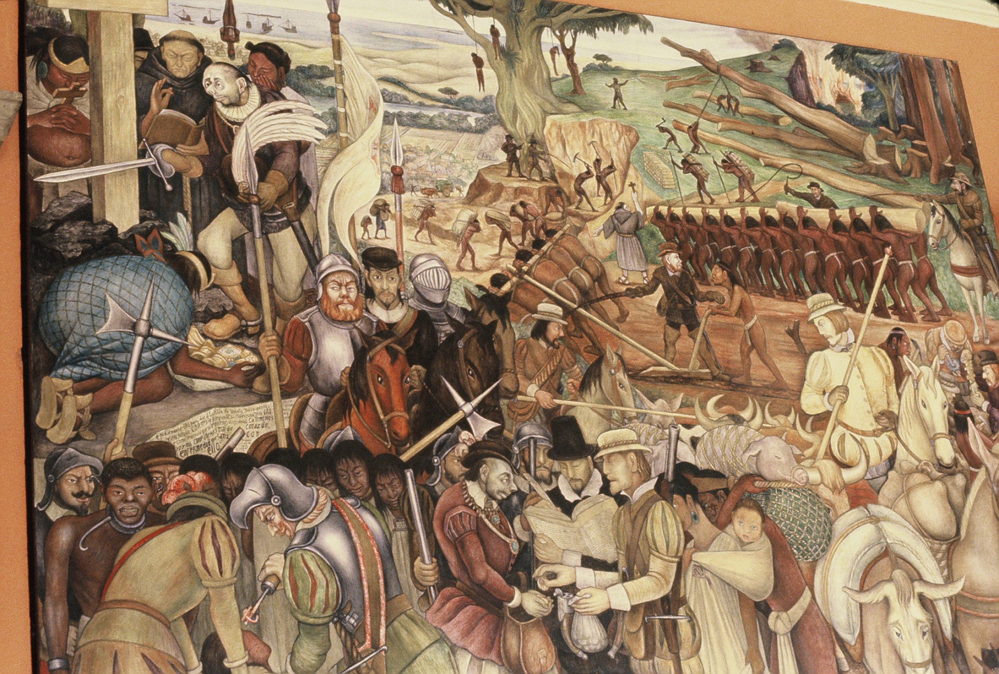
Diego Rivera depicting Spanish Colonizers

Slide 11
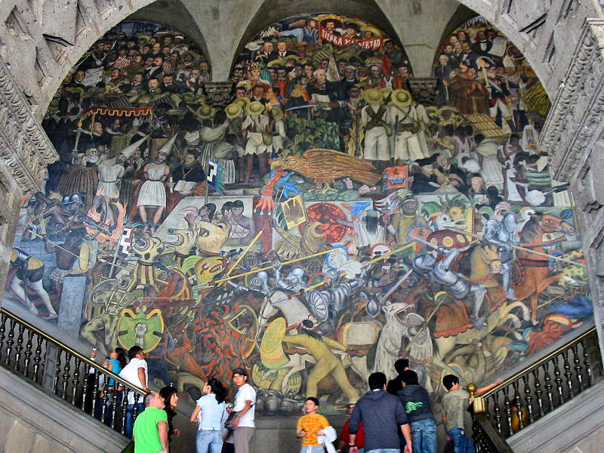
Diego Rivera, Conquest to Revolution

Slide 12
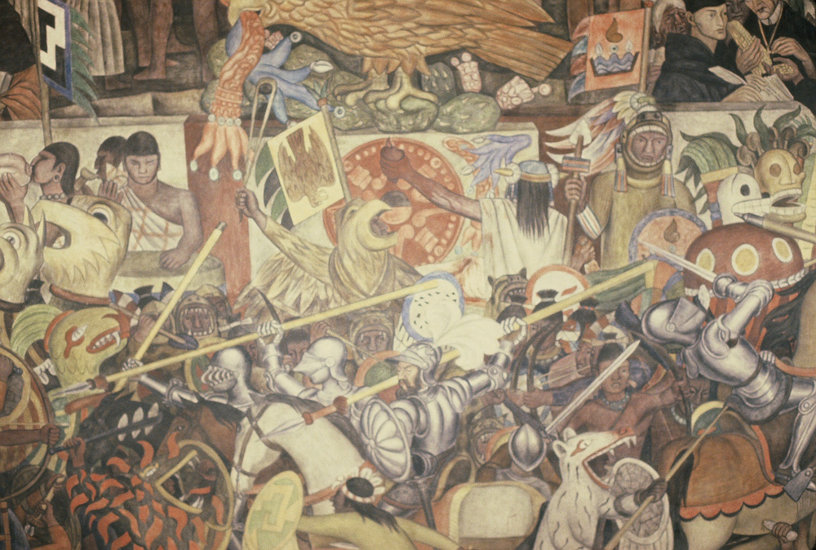
Diego Rivera, Conquest to Revolution

Slide 13
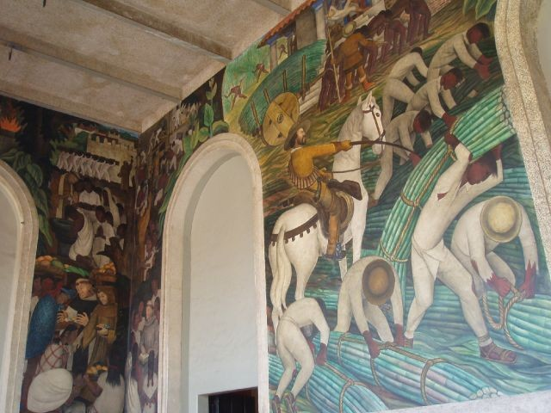
Diego Rivera Mural, Cuernavaca, Colonialism

Slide 14
El Grito de Dolores
Full Version of the Cry of Dolores today
Mexicans! Long live the heroes that gave us the Fatherland!
Long live Hidalgo!
Long live Morelos!
Long live Josefa Ortiz de Dominguez!
Long live Allende!
Long live Aldama and Matamoros!
Long live National Independence!
Long Live Mexico! Long Live Mexico! Long Live Mexico!

Slide 15
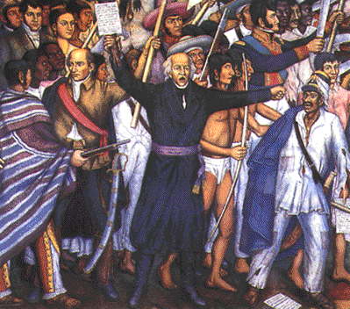
Father Hidalgo

Slide 16
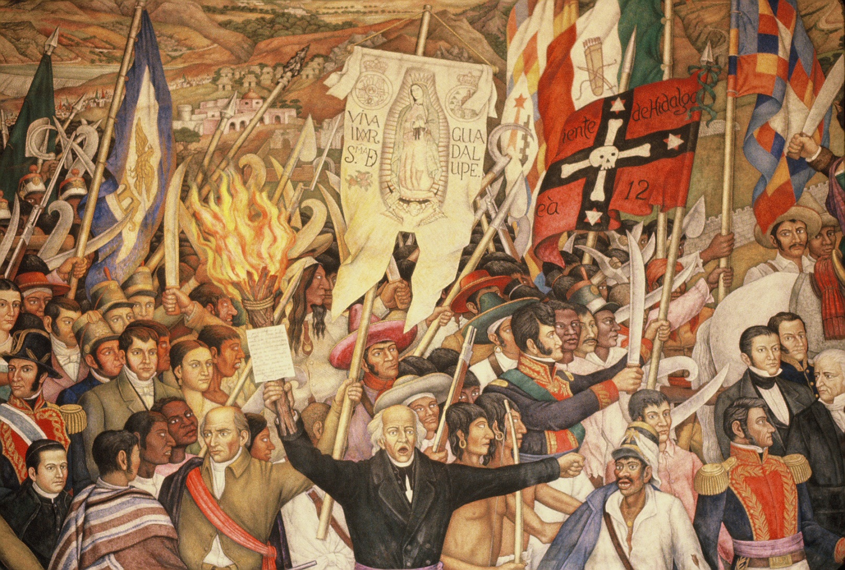
Hidalgo

Slide 17
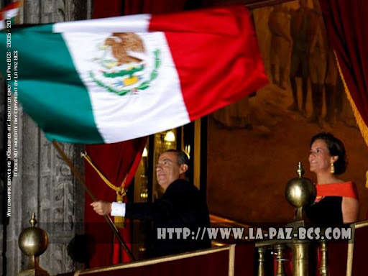
Calderon and El Grito

Slide 18
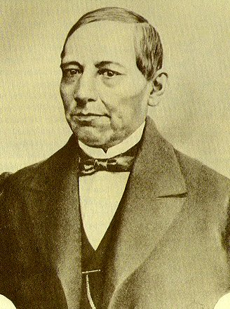
Benito Juarez

Slide 19
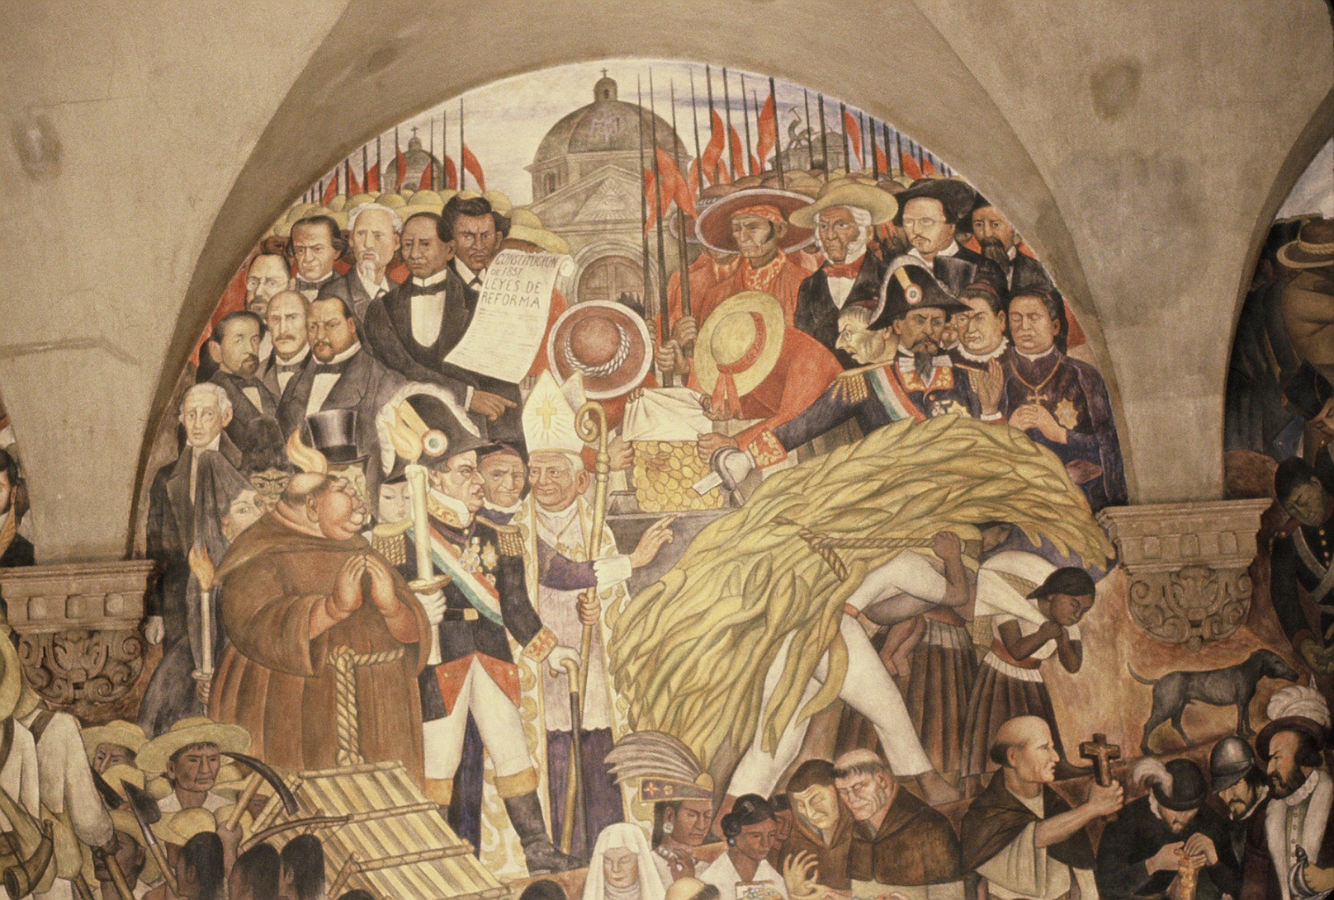
Benito Juarez and the Church

Slide 20
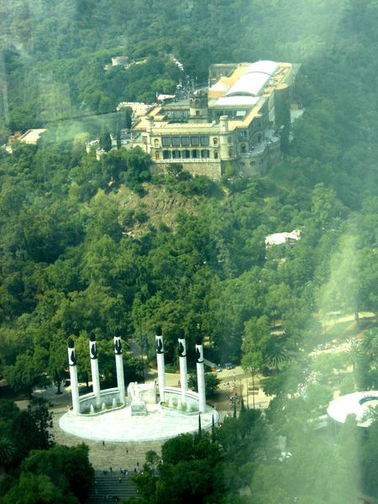
Chapultepec Castle and Ninos Heroes

Slide 21
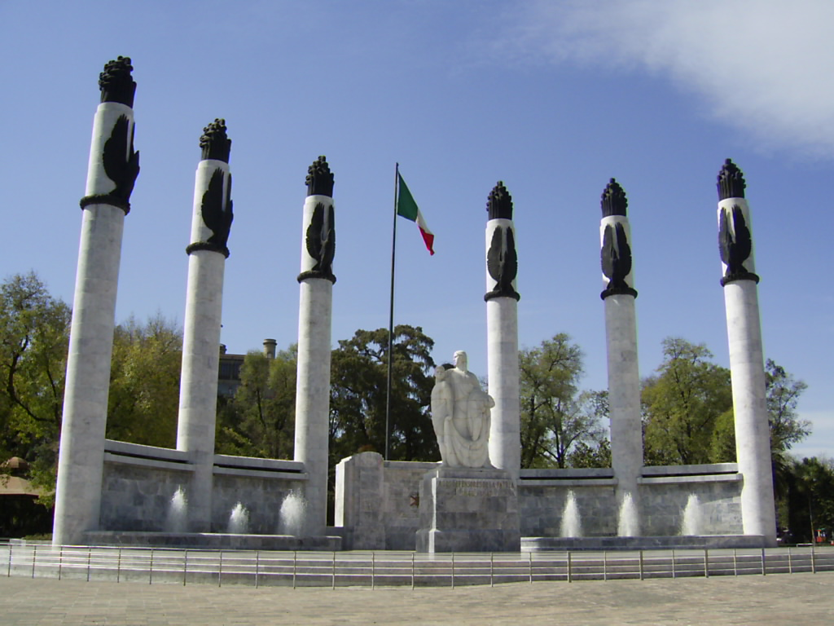
Ninos Heroes

Slide 22
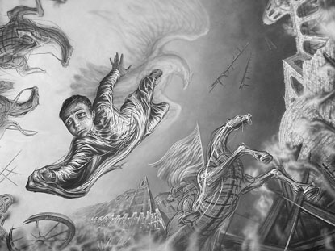
Ninos Heroes, Orozco Mural

Slide 23
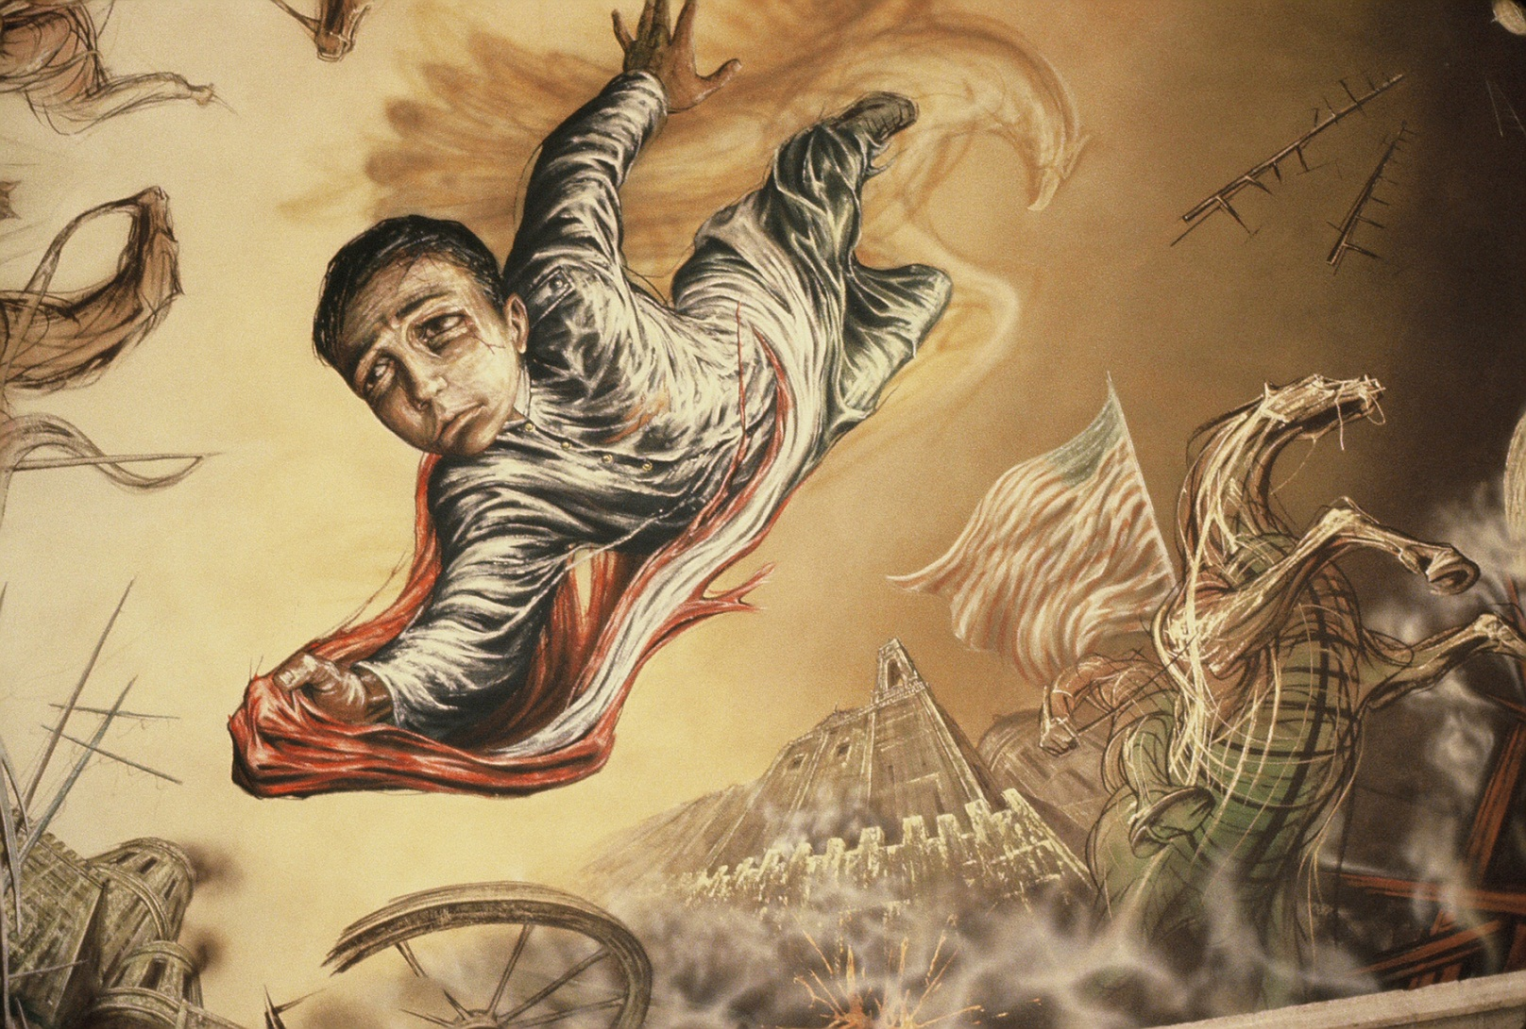
Ninos Heroes

Slide 24
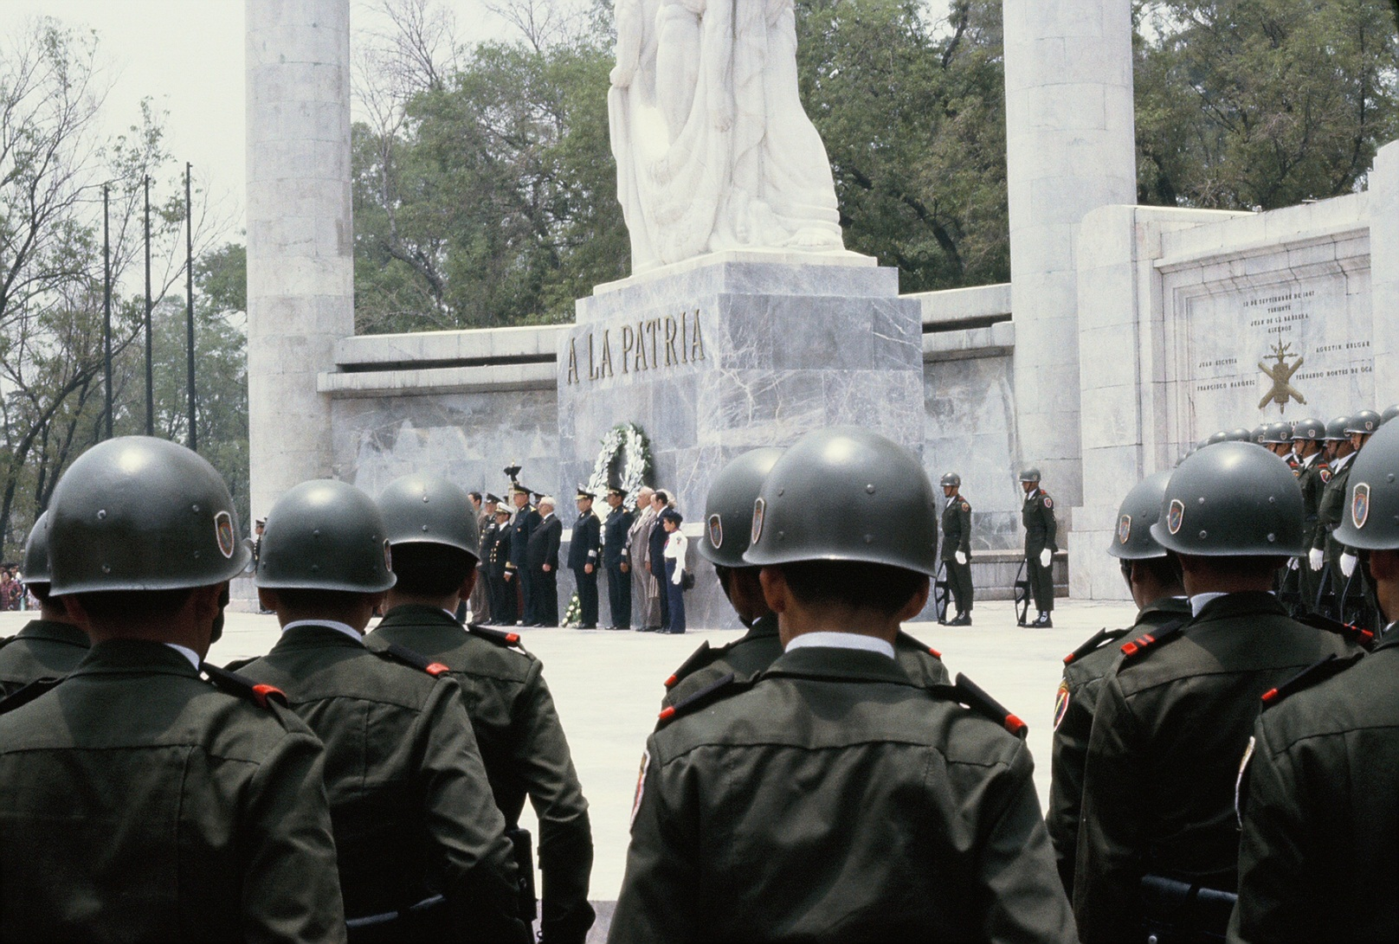
Ninos Heroes

Slide 25
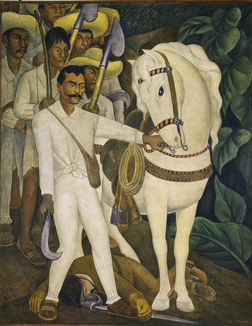
Zapata

Slide 26
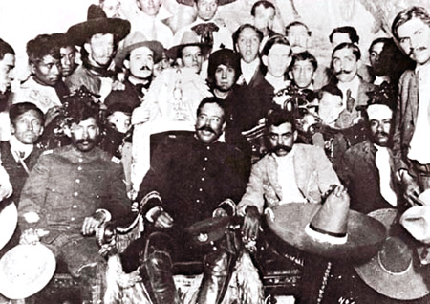
Villa and Zapata in Mexico City

Slide 27
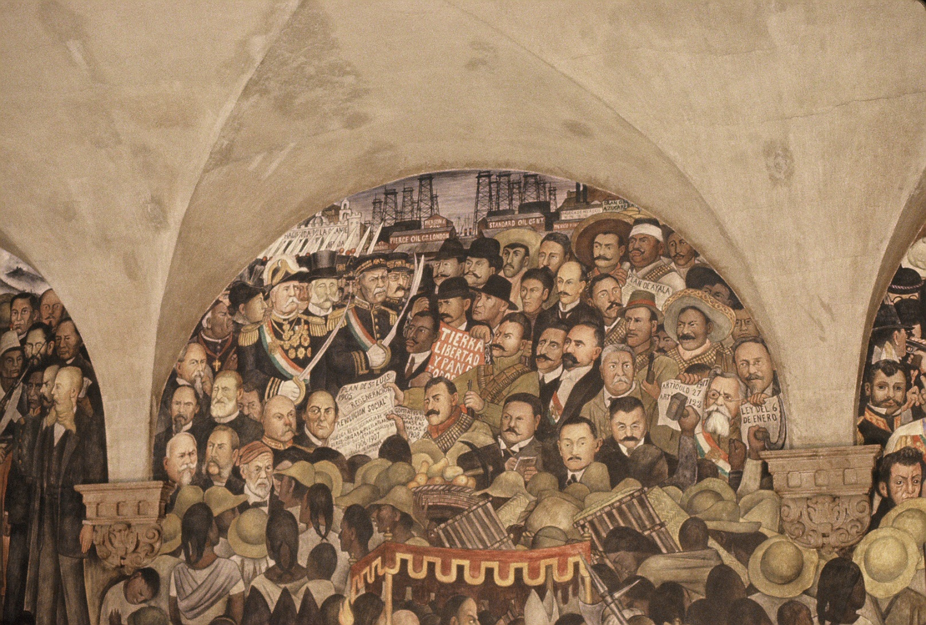
Revolution to Oil Nationalizations

Slide 28
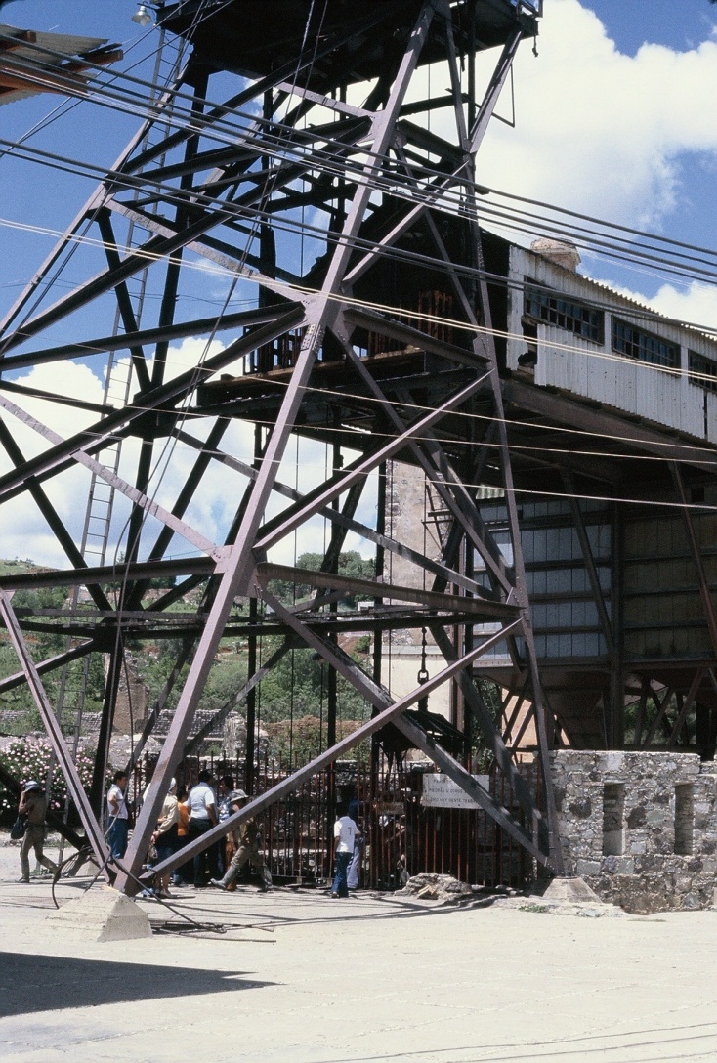
Abandoned Silver Mine

Slide 29
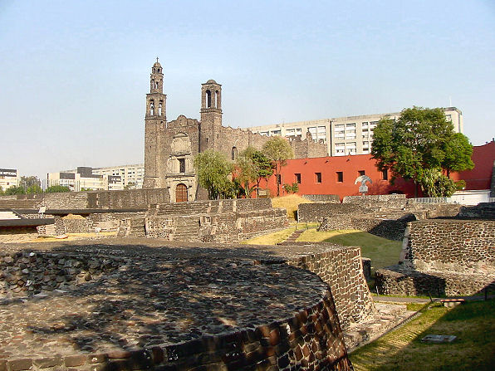
Tlatelolco

Slide 30
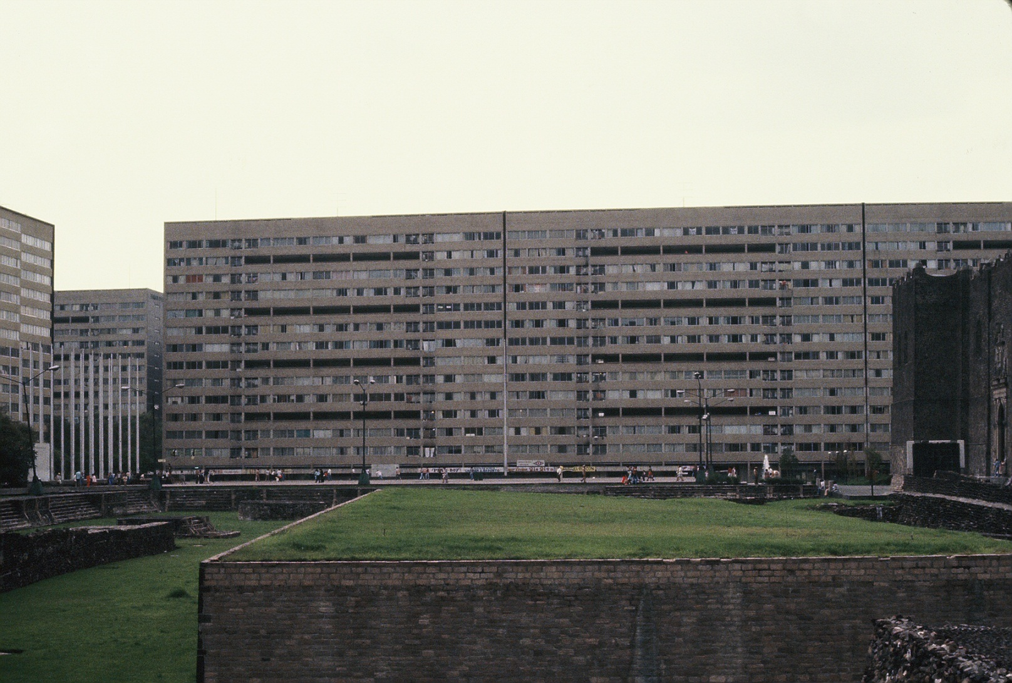
Tlatelolco

Slide 31
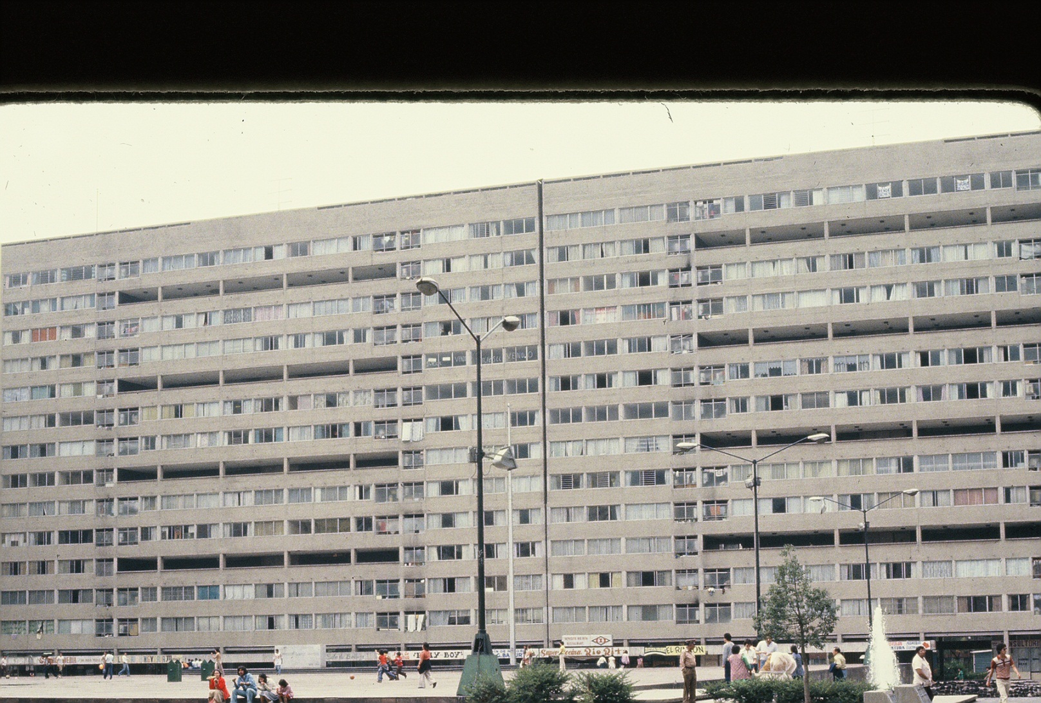

Slide 32
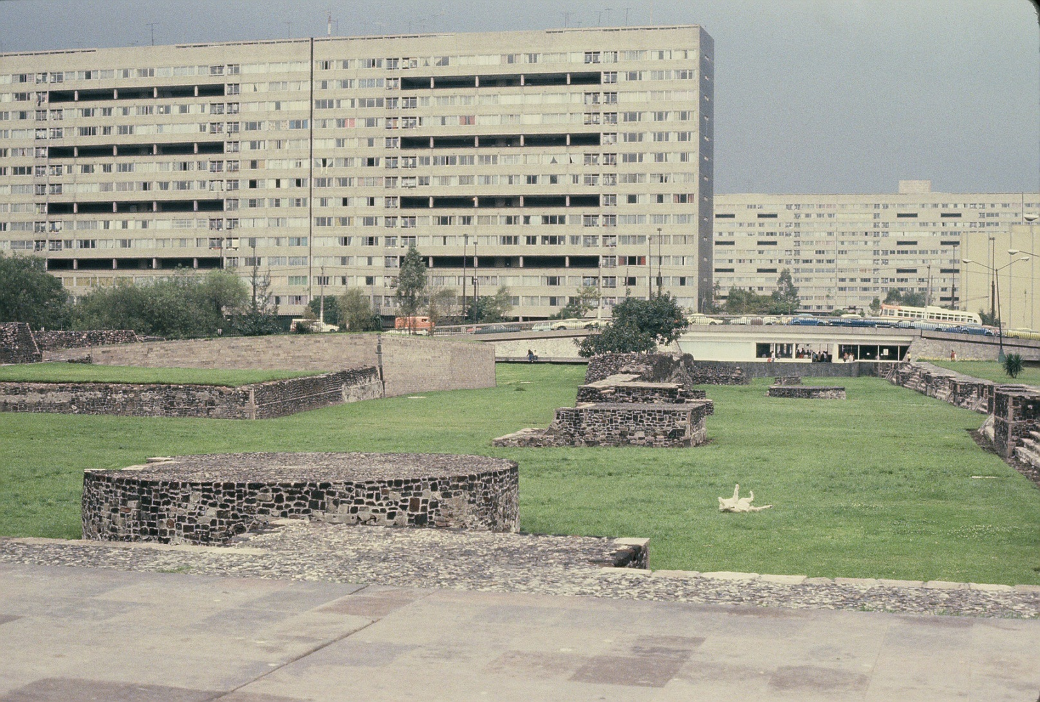
Tlatelolco

Slide 33
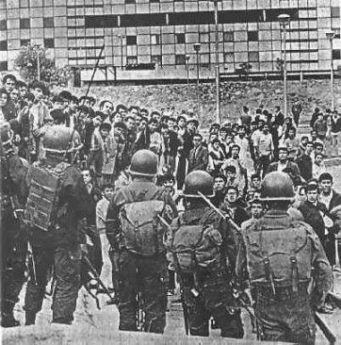
Tlatelolco

Slide 34
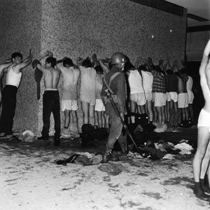
Tlatelolco

Slide 35
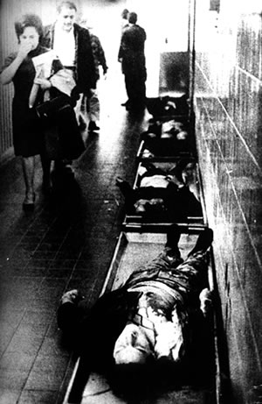
Tlatelolco

Slide 36
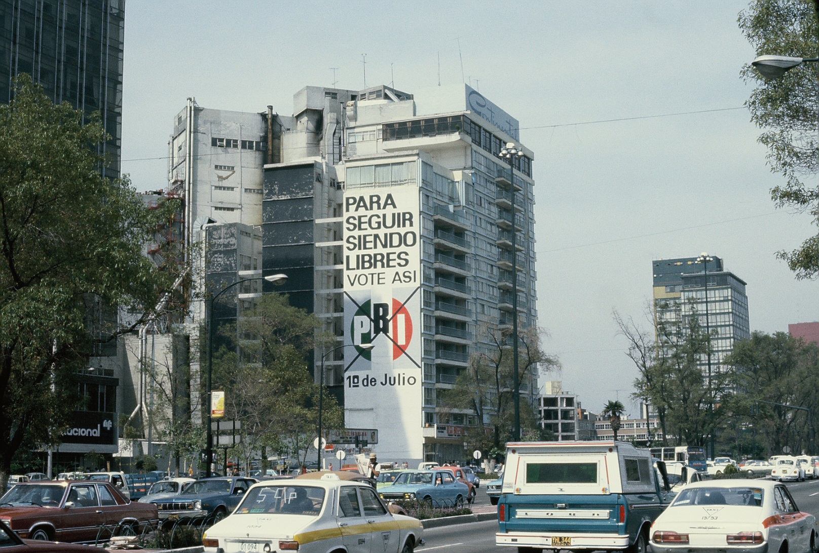
PRI

Slide 37
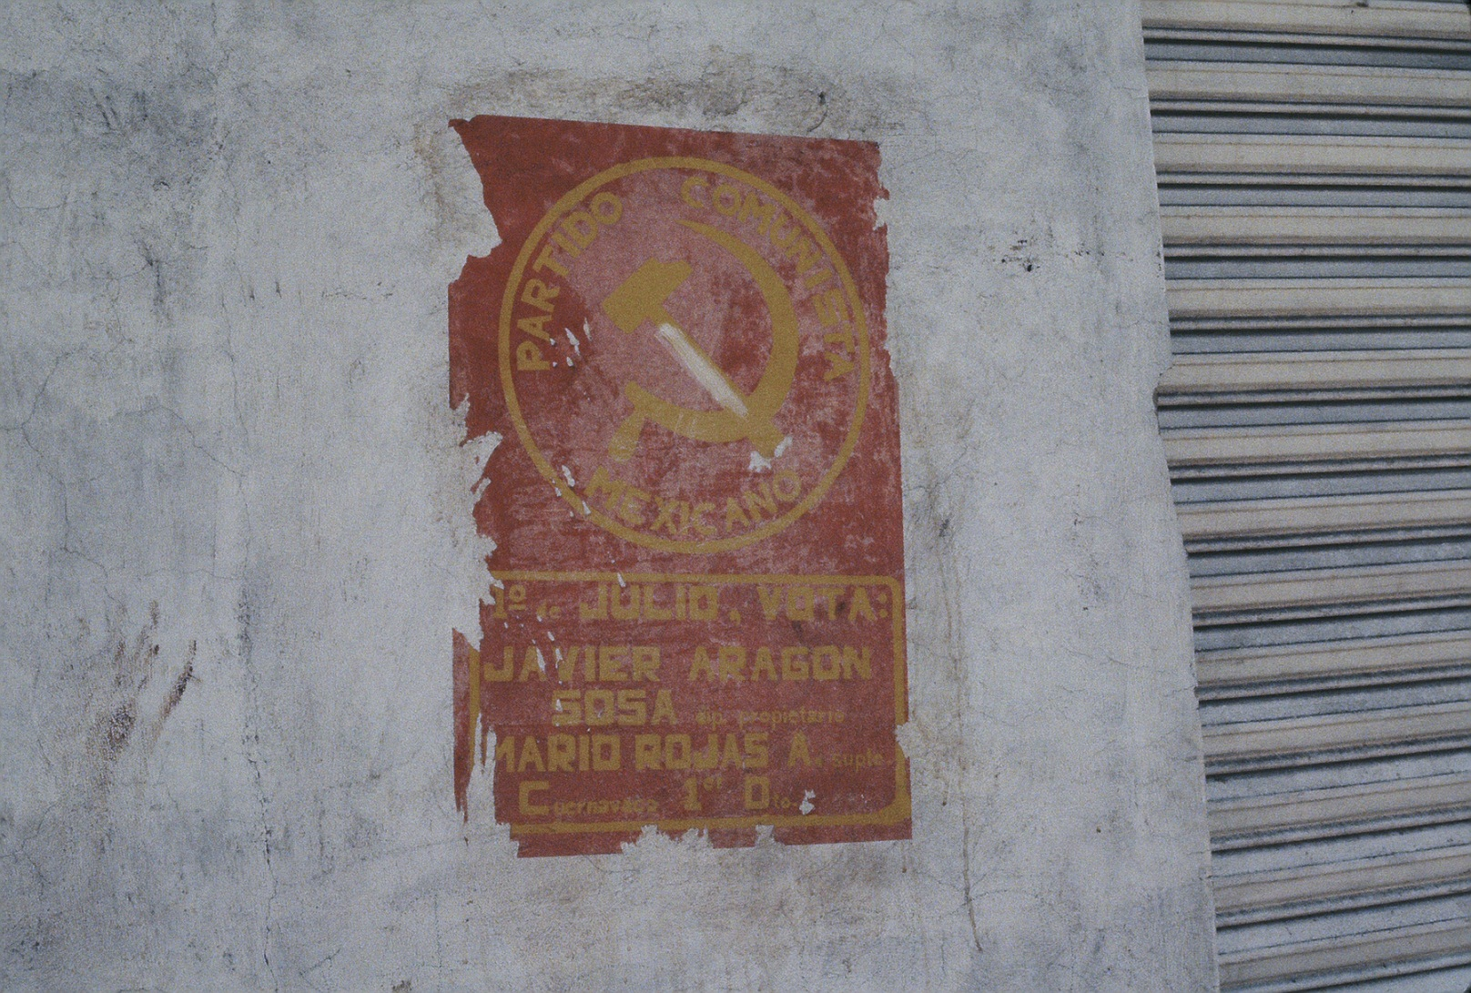
PCM

Slide 38
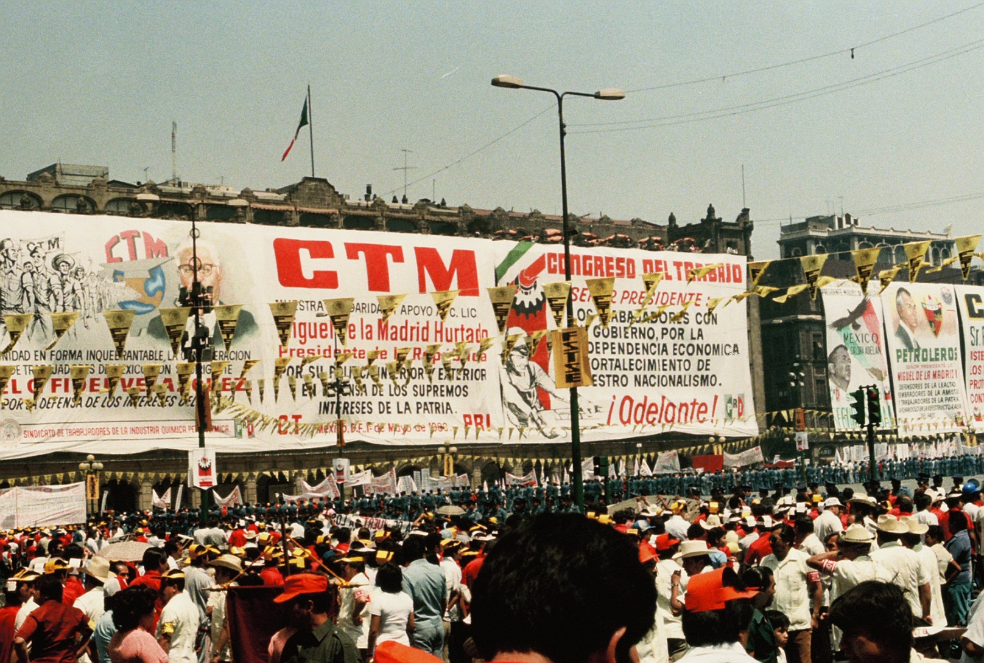
May Day

Slide 39
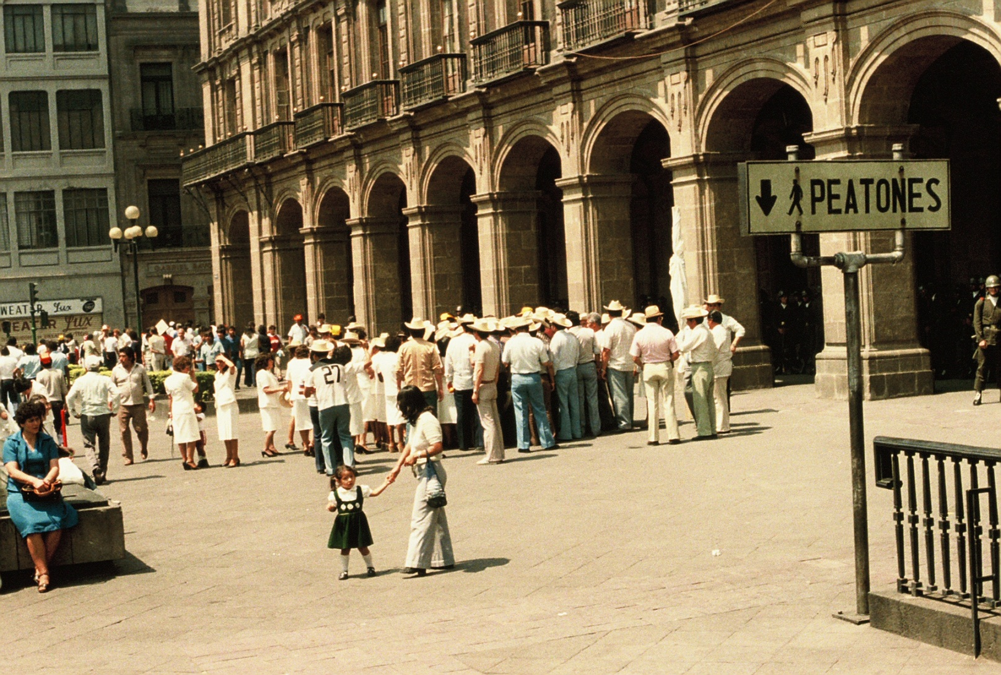
May Day

Slide 40
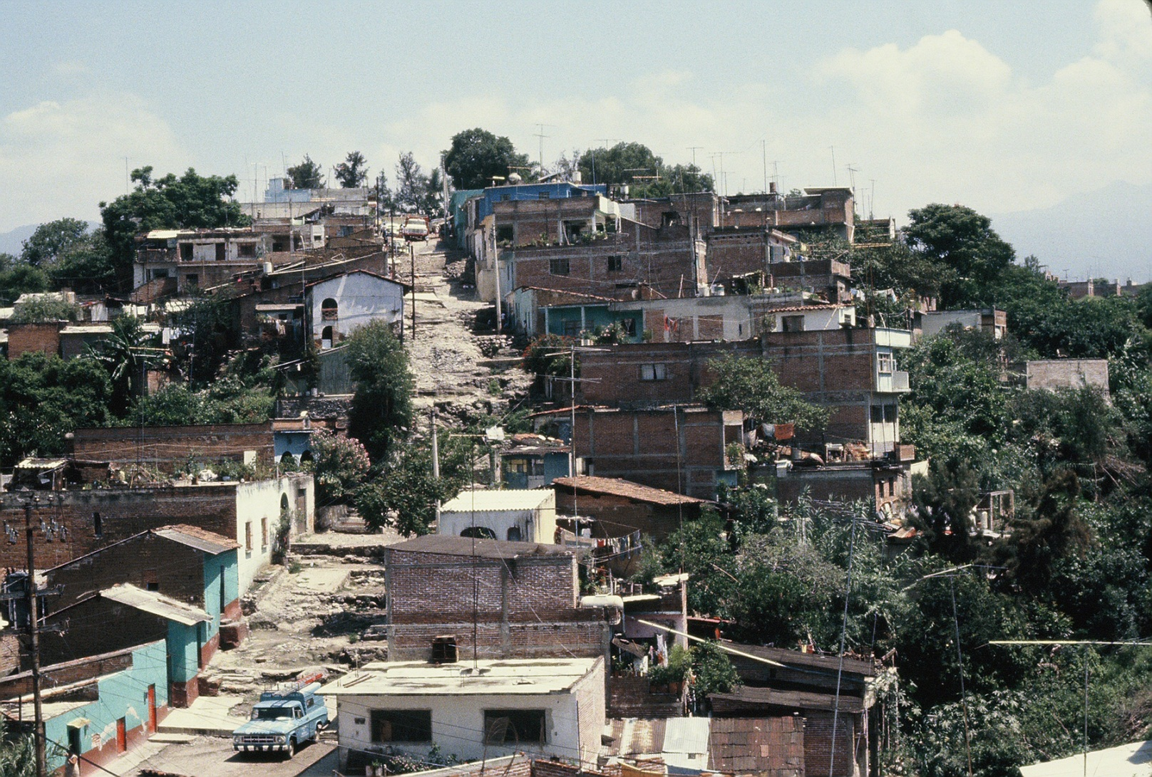
Squatters

Slide 41
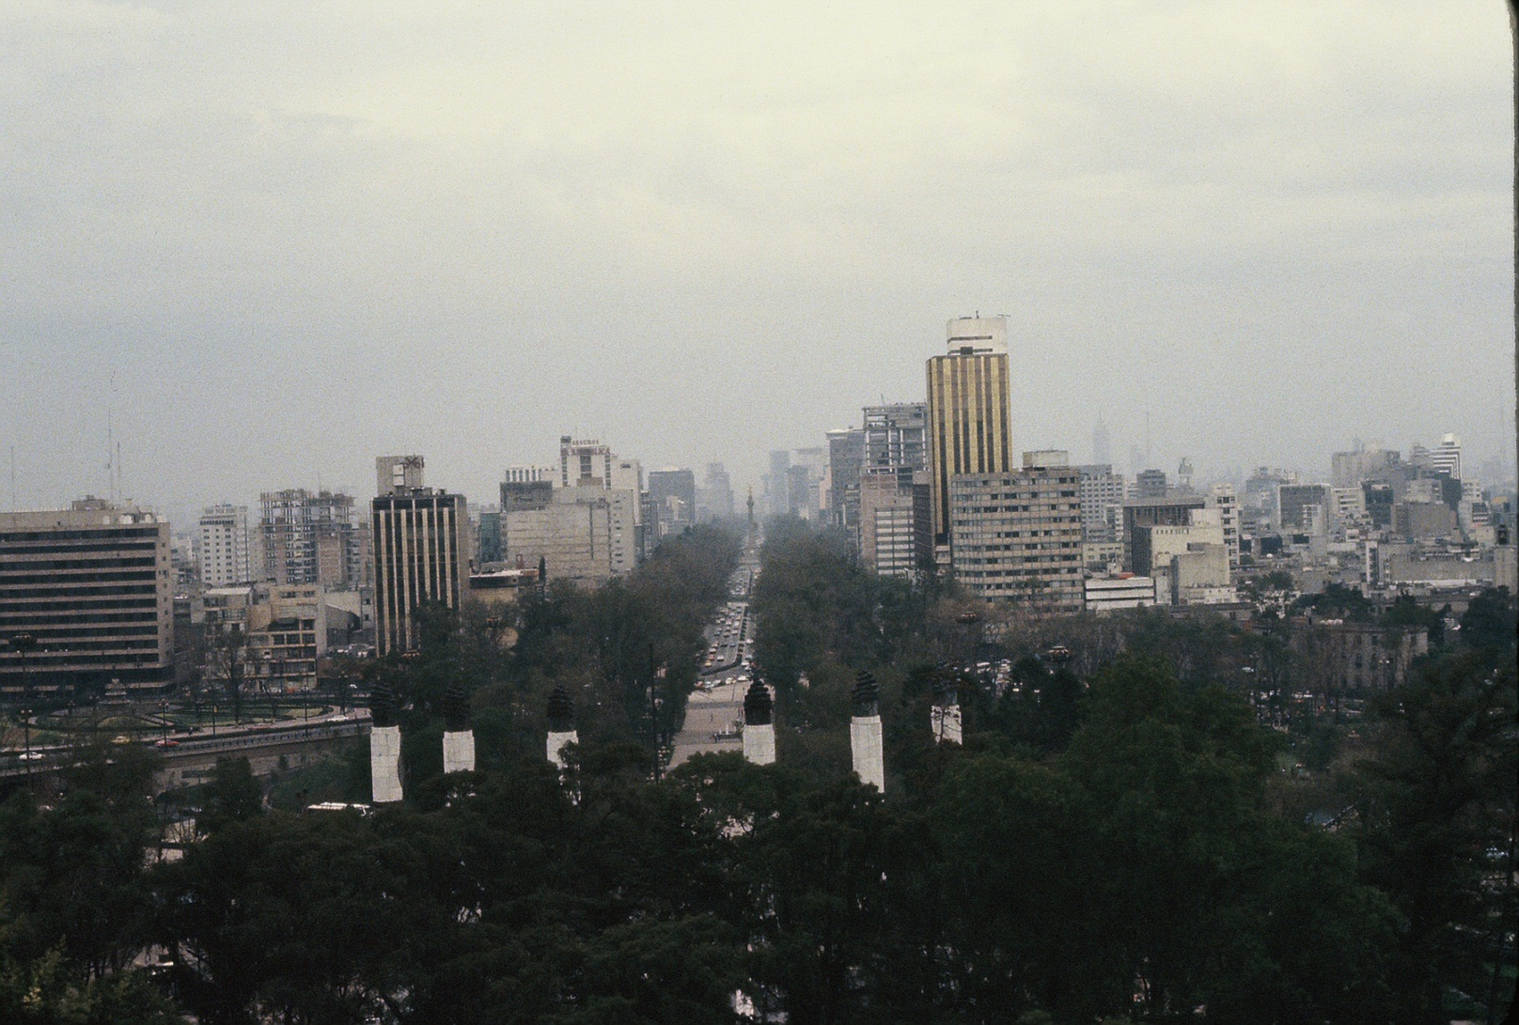
Mexico City

Slide 42
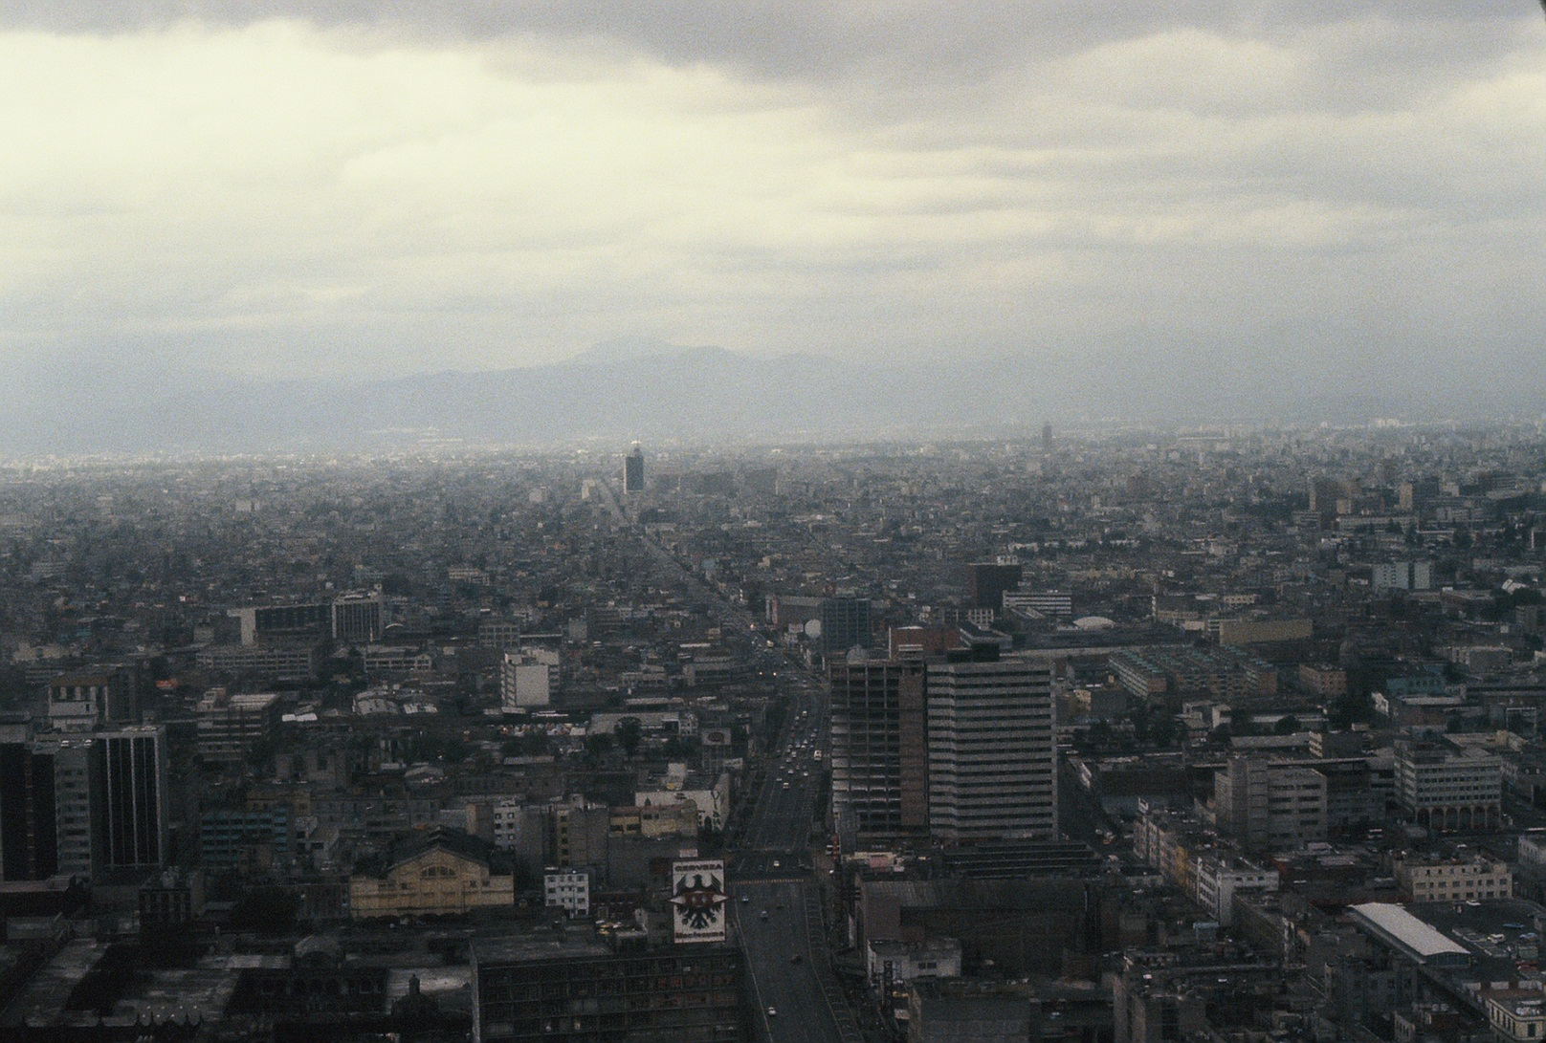
Mexico City

Slide 43
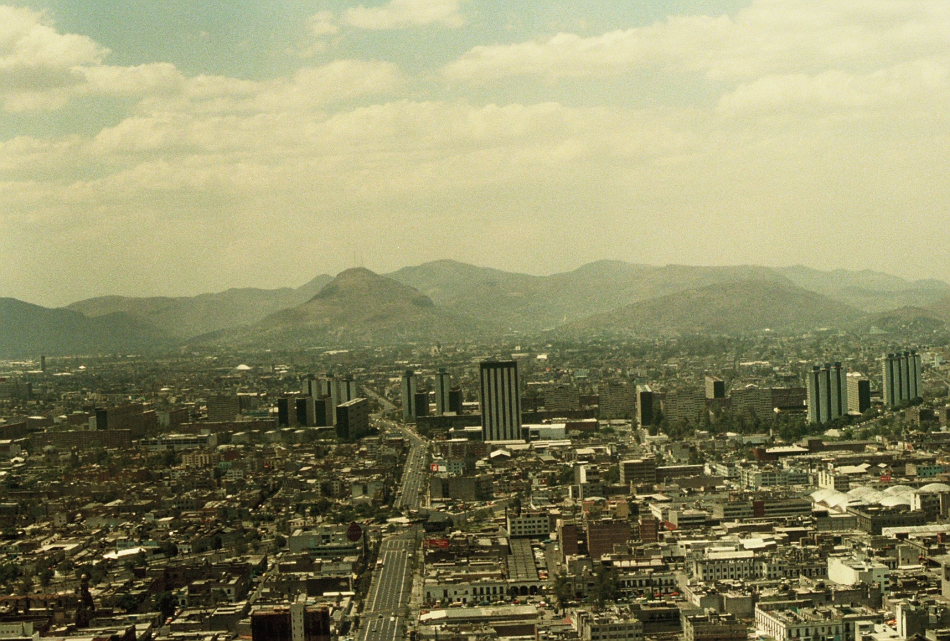
Mexico City

Slide 44
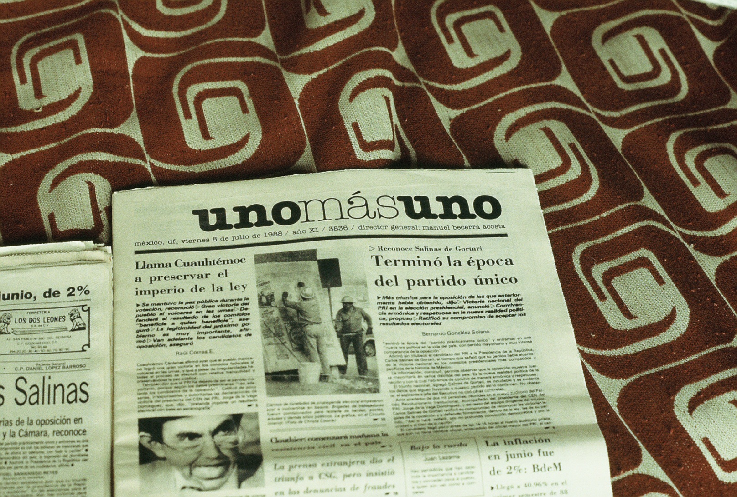
1988 Election

Slide 45
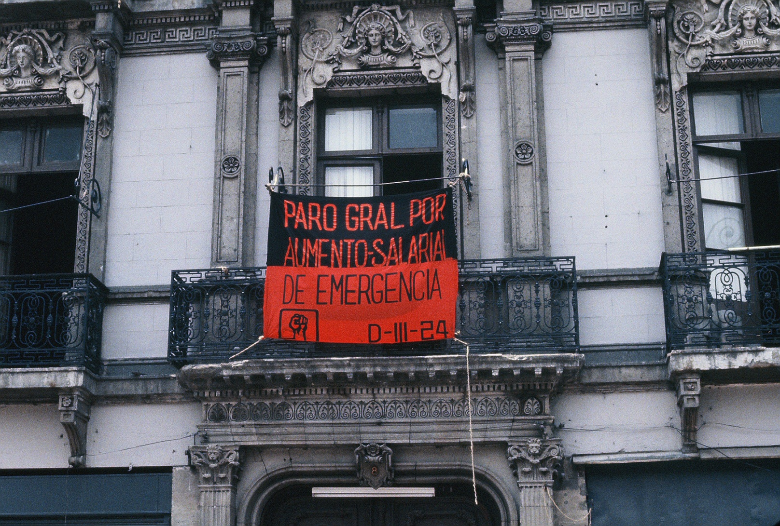
Huelga!

