Slide 1
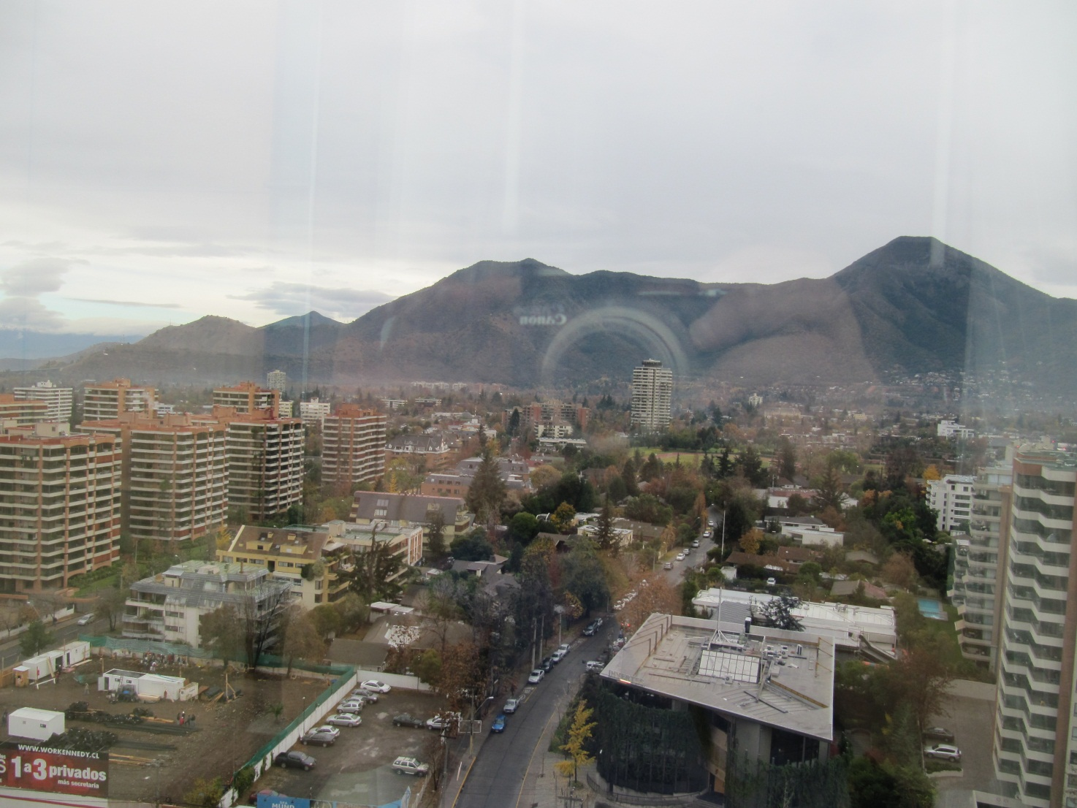
Andes, Santiago, Chile

Slide 2
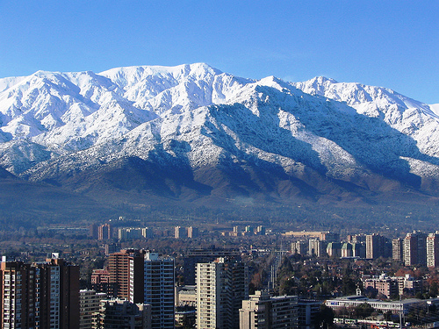
Andes, Santiago, Chile

Slide 3
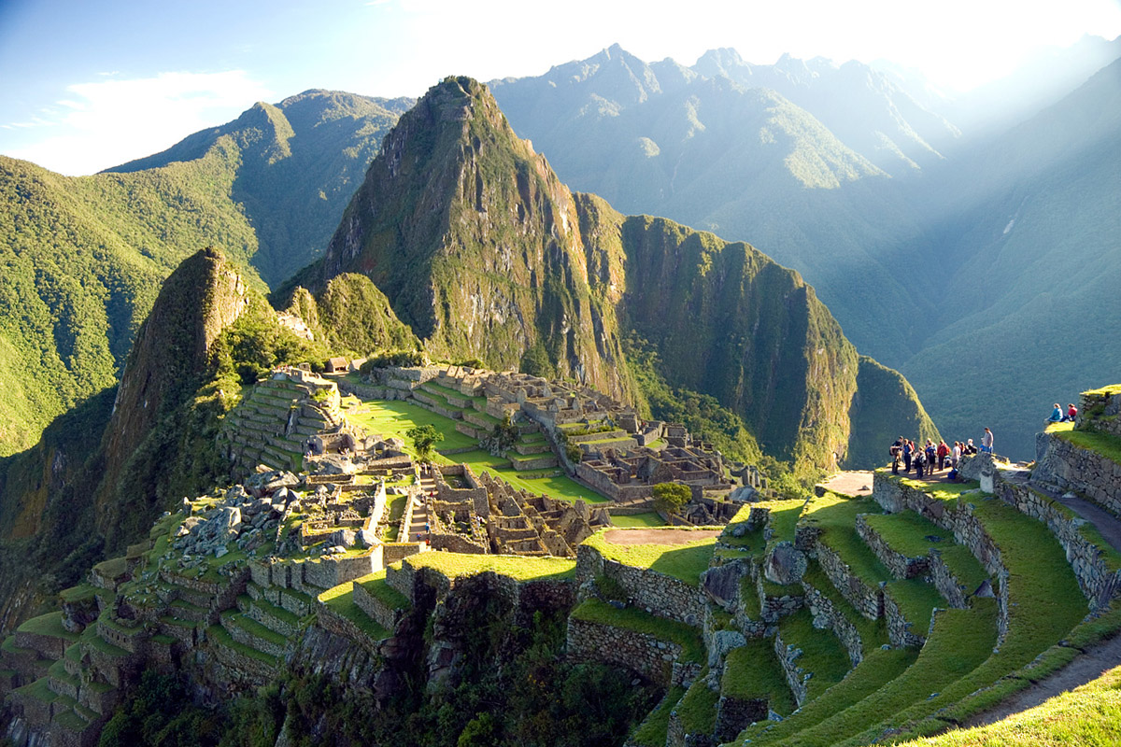
Andes, Machu Picchu, Peru

