Slide 1
Villa Grimaldi, Chile
After the military coup of 1973, this site was taken over by the National Intelligence Directorate (DINA)

Slide 2
Villa Grimaldi was one of the clandestine torture, detention, and extermination centers from 1973-1978
It is estimated that around 4500 political prisoners passed through this secret detention center

Slide 3
President Michelle Bachelet spent her first days of detention in January, 1975 at Villa Grimaldi.
She was transferred to another detention center (Cuatro Alamos) and released later in 1975
Due to supporters of her father in the military, she and her mother were released and went into exile in Australia

Slide 4
Her father, General Alberto Bachelet Martinez, had been in charge of the Food Distribution Office in the Allende Government. He was charged with treason by Pinochet, imprisoned, and died in prison.

Slide 5
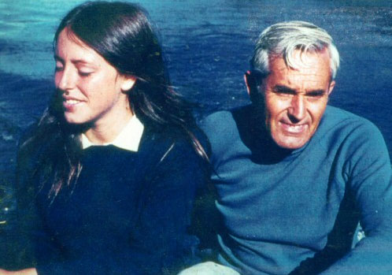
Michelle Bachelet and her Father

Slide 6
When the families of the victims were finally given access to Villa Grimaldi in 1994, they found most the buildings and structures destroyed.
Through the efforts of the families and many human rights organizations, the site was partially reconstructed and opened in 1997 as The Villa Grimaldi Park for Peace.

Slide 7
October 14, 2006, Michelle Bachelet returned to the place of her initial detention. This was the first Presidential visit to the Villa Grimaldi Park for Peace.
After the death of Augusto Pinochet, President Bachelet did not attend his funeral--saying it would be "a violation of [her] conscience" to attend.

Slide 8
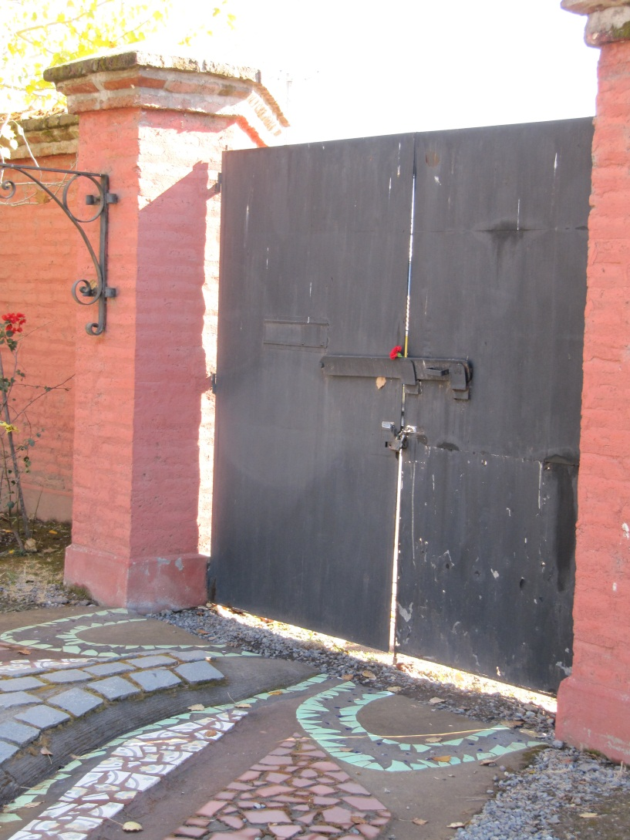
Gate of Entry for Prisoners

Slide 9
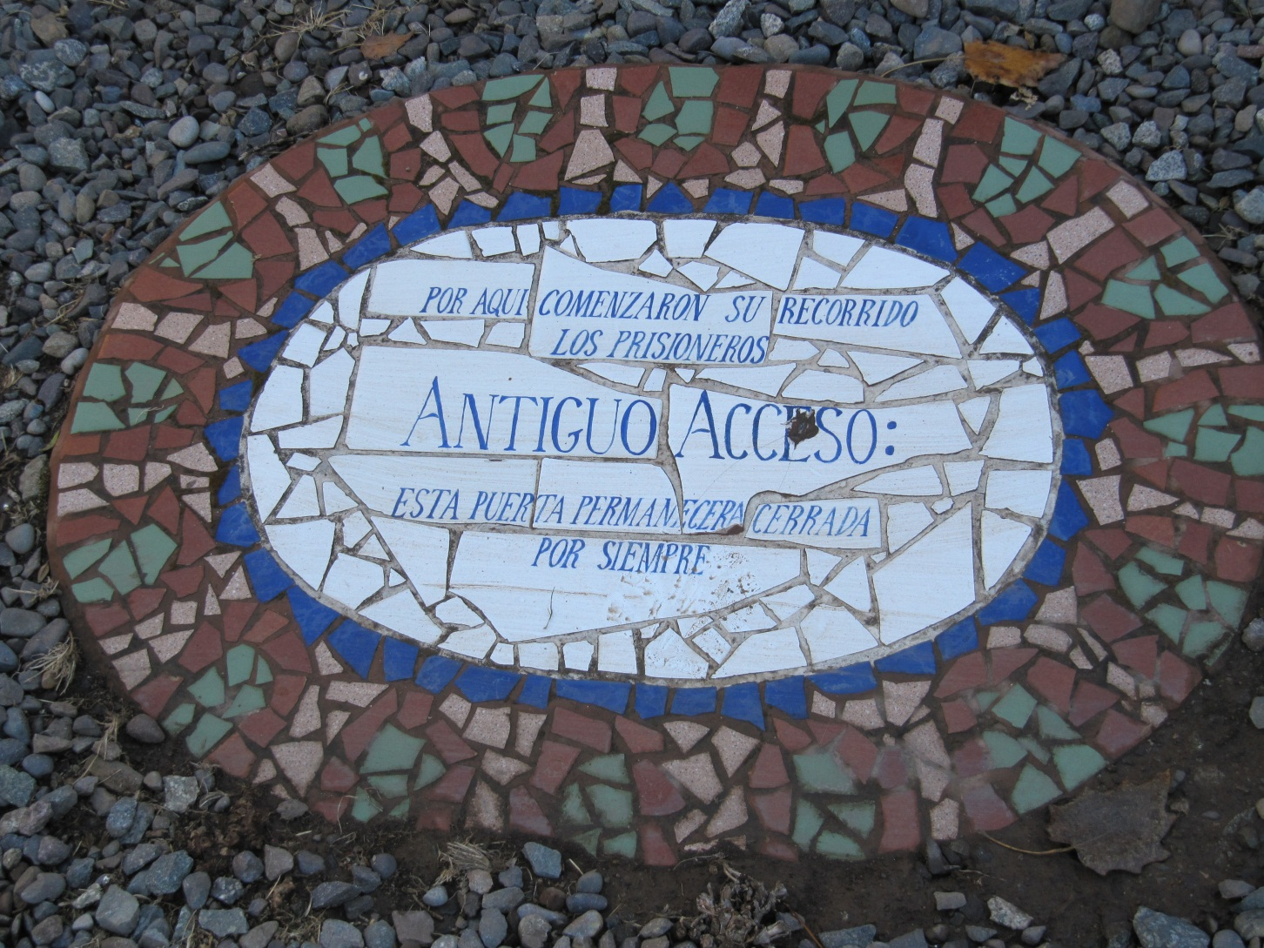
Gate PermanentlyClosed

Slide 10
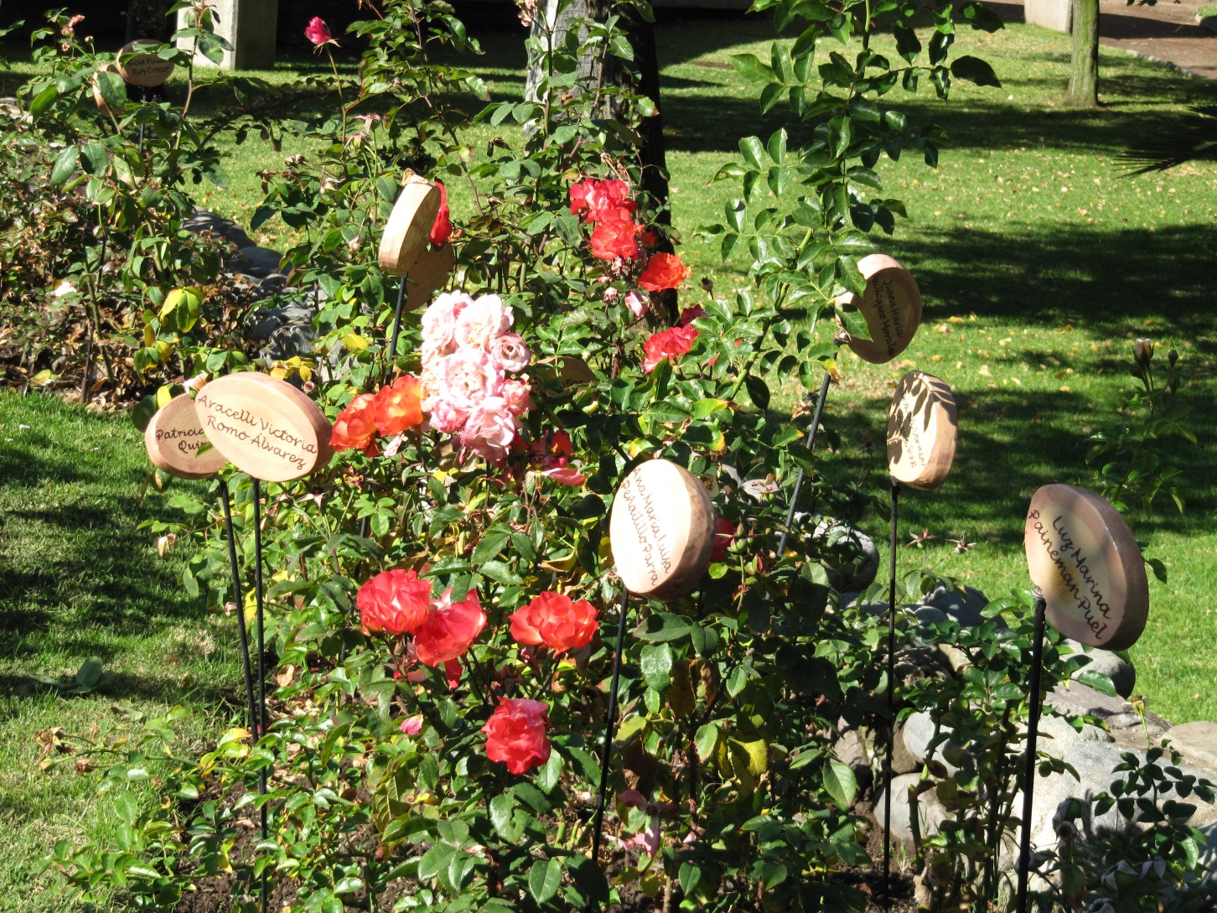
“Rose Garden” with Names of Women who disappeared here

Slide 11
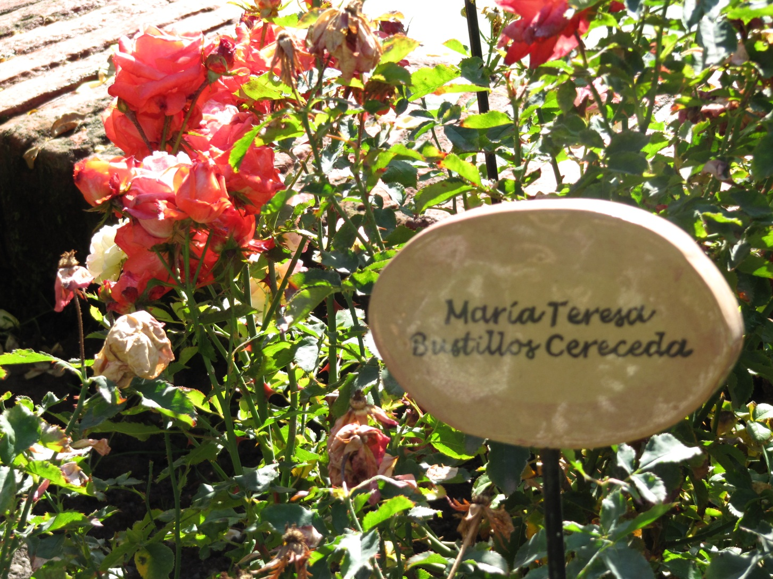
Rose Garden

Slide 12
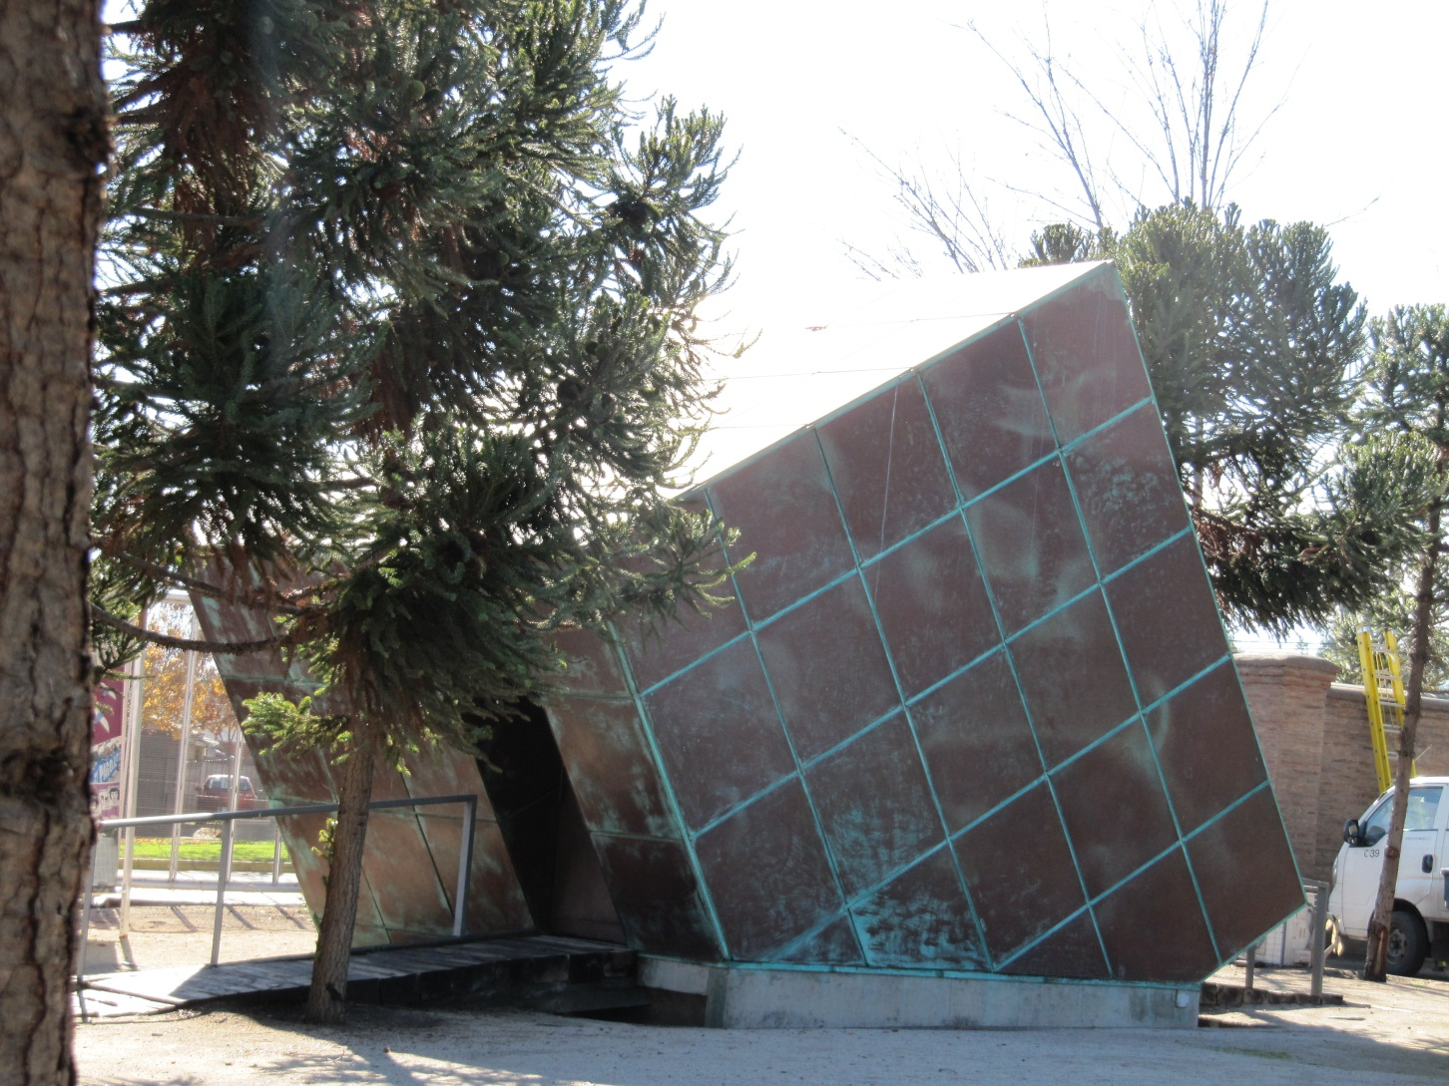
Monument containing rails extracted from the Quintero Bay.

Slide 13
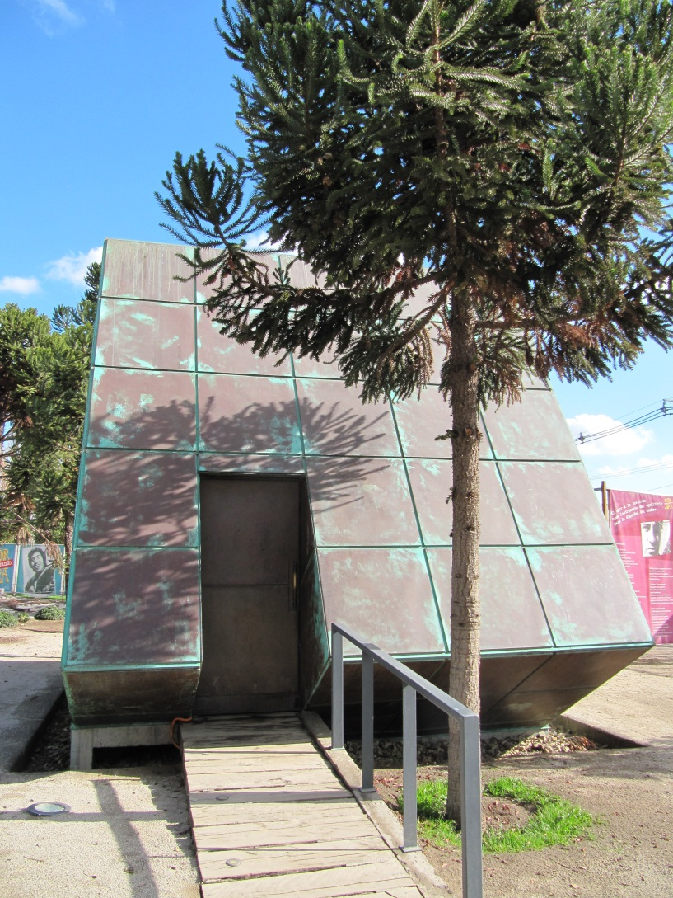
The rails were used to weigh down bodies of victims which were dropped in to the sea from helicopters.

Slide 14
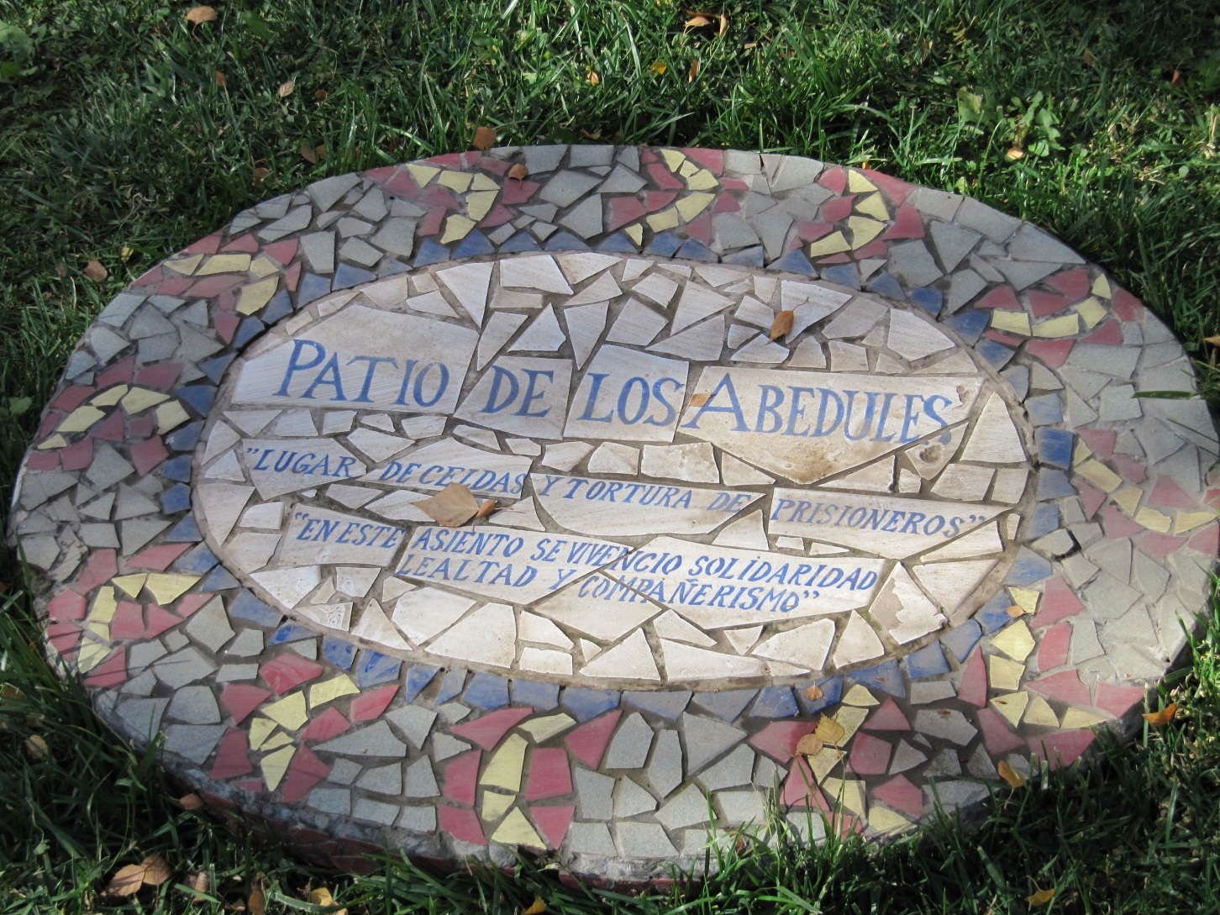
Marking the location of detention cells

Slide 15
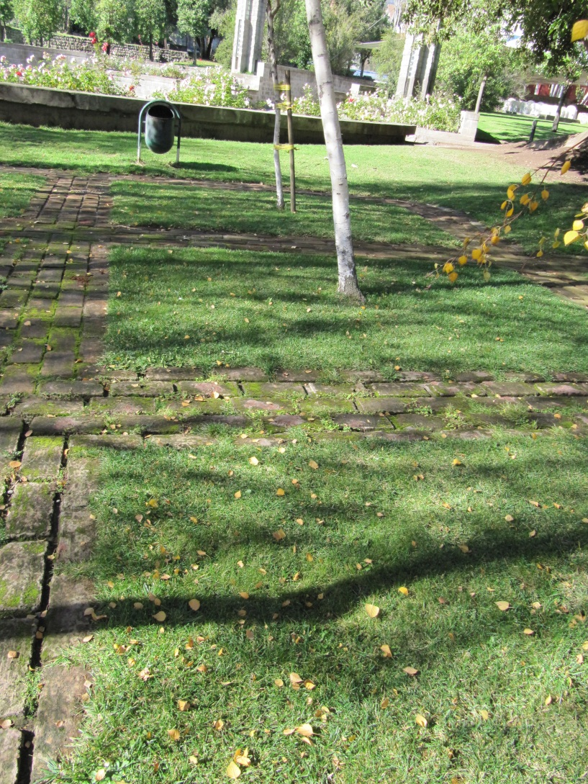
Grid of bricks among birch trees demarcate prisoner’s cells

Slide 16
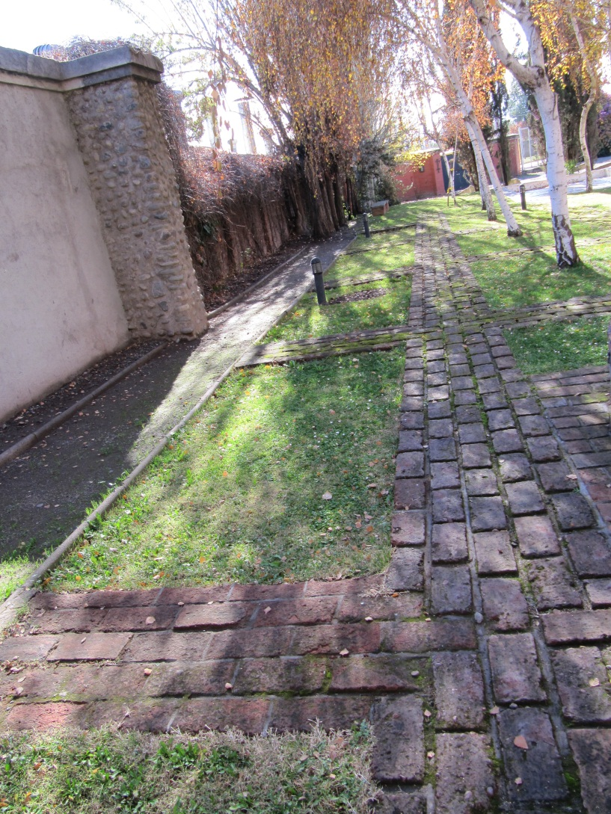
Birch courtyard next to the brick wall

Slide 17
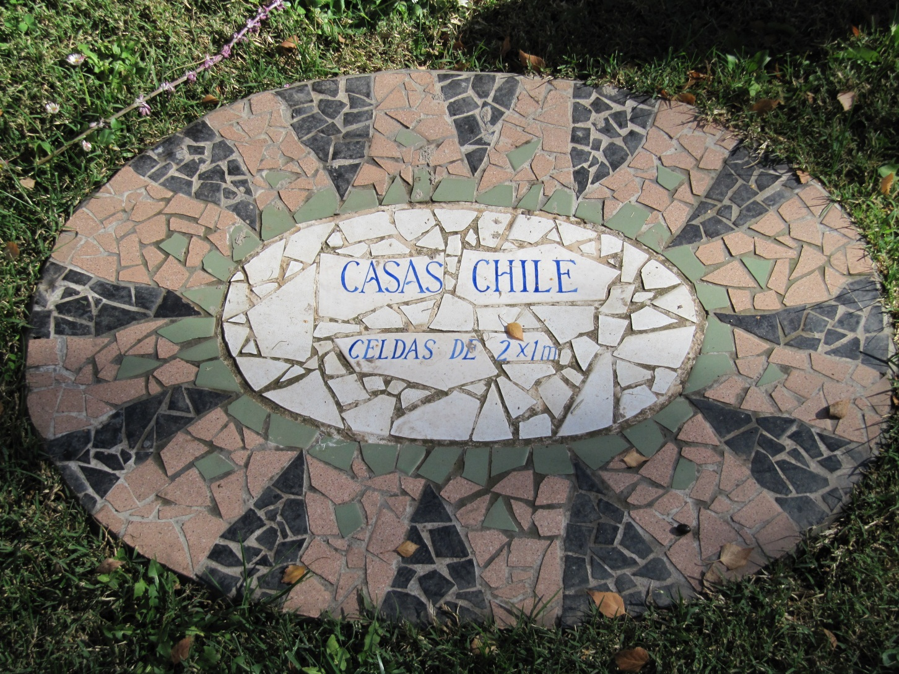
Cells measuring some 3’ by 6’

Slide 18
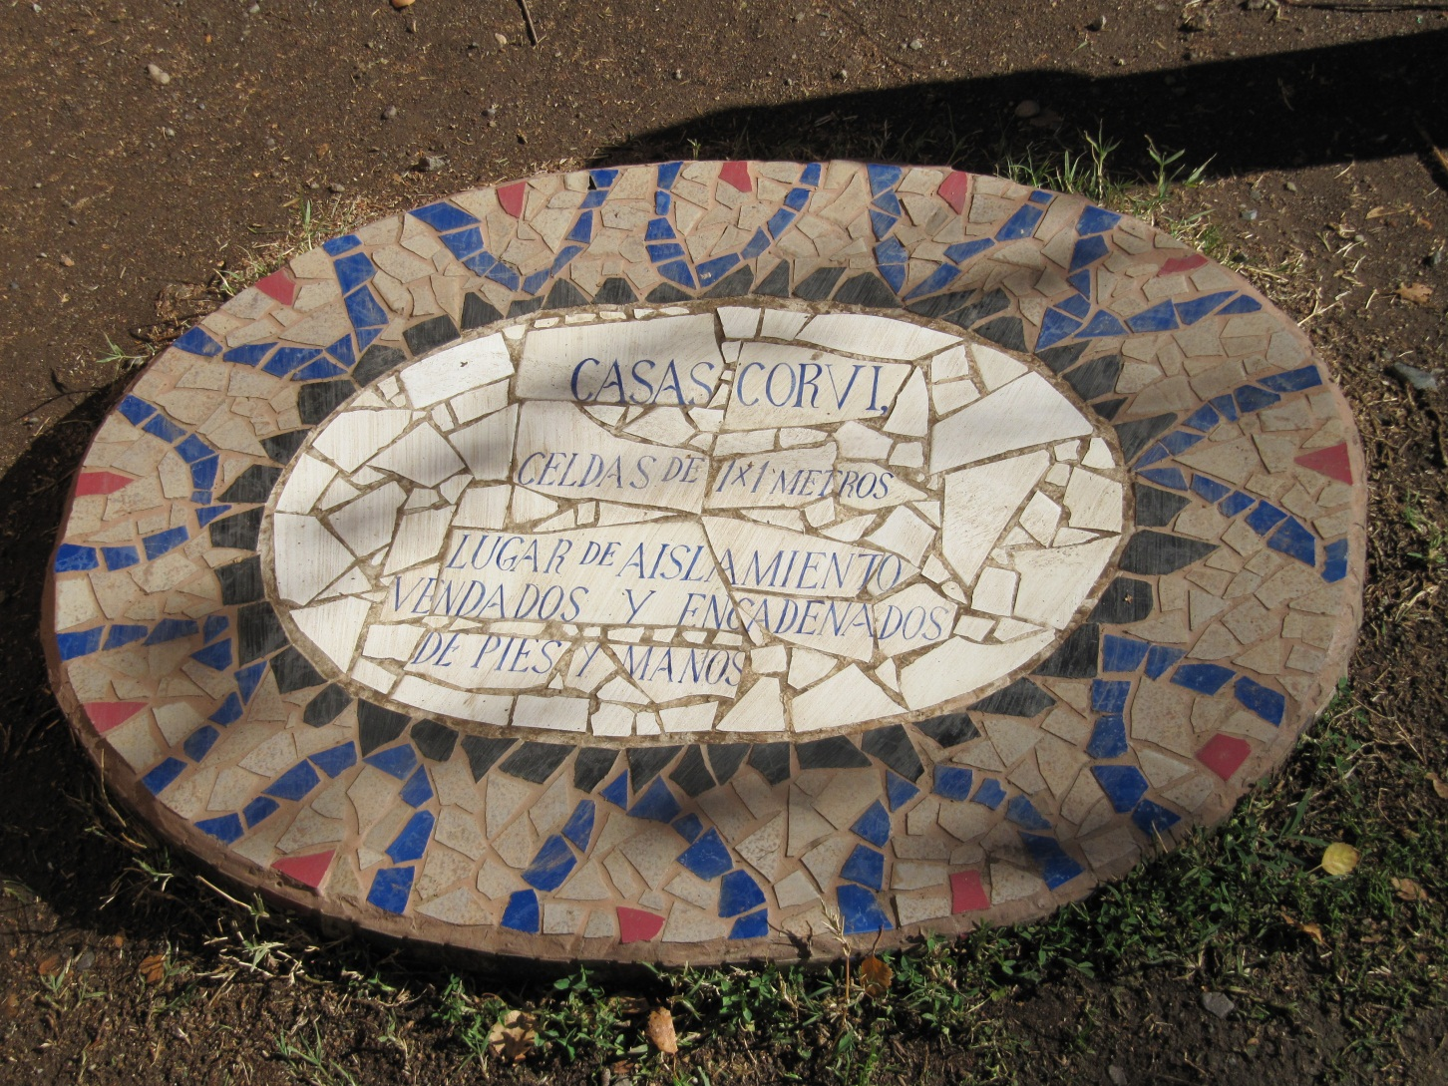
Even smaller cells

Slide 19
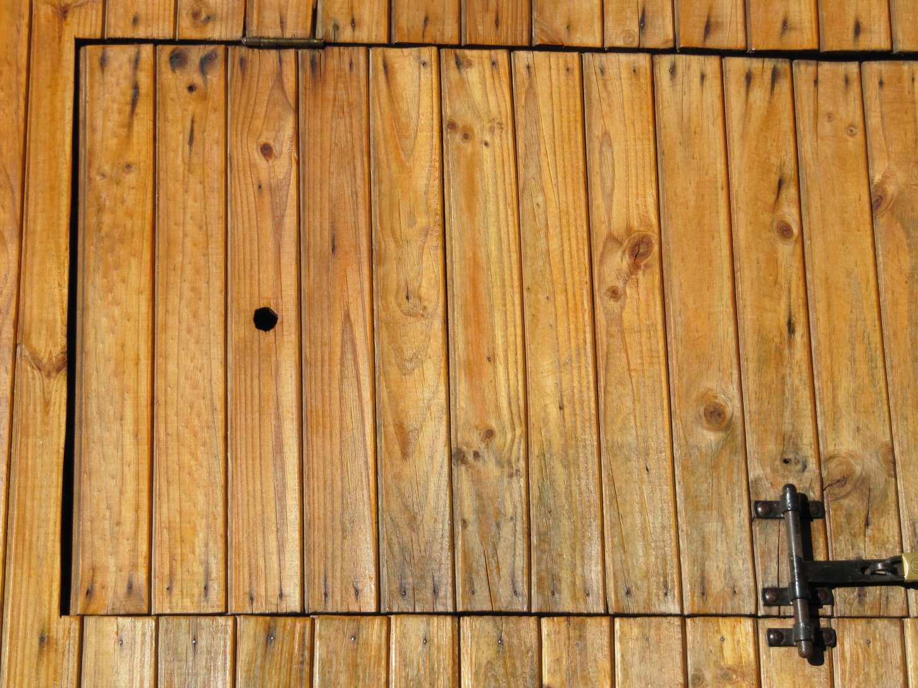
Door of reconstructed cell with peep hole

Slide 20
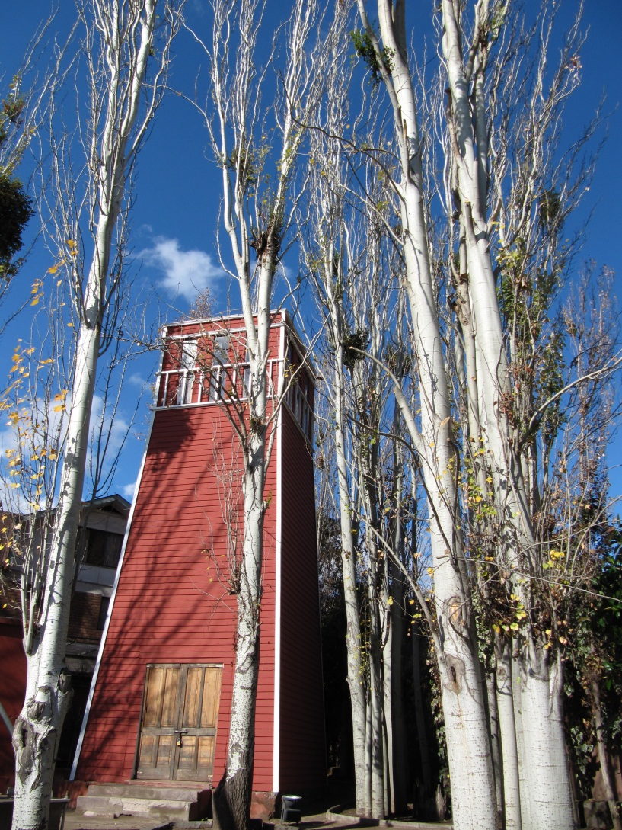
Reconstructed “Tower”—often the last known location of prisoners before they disappeared

Slide 21
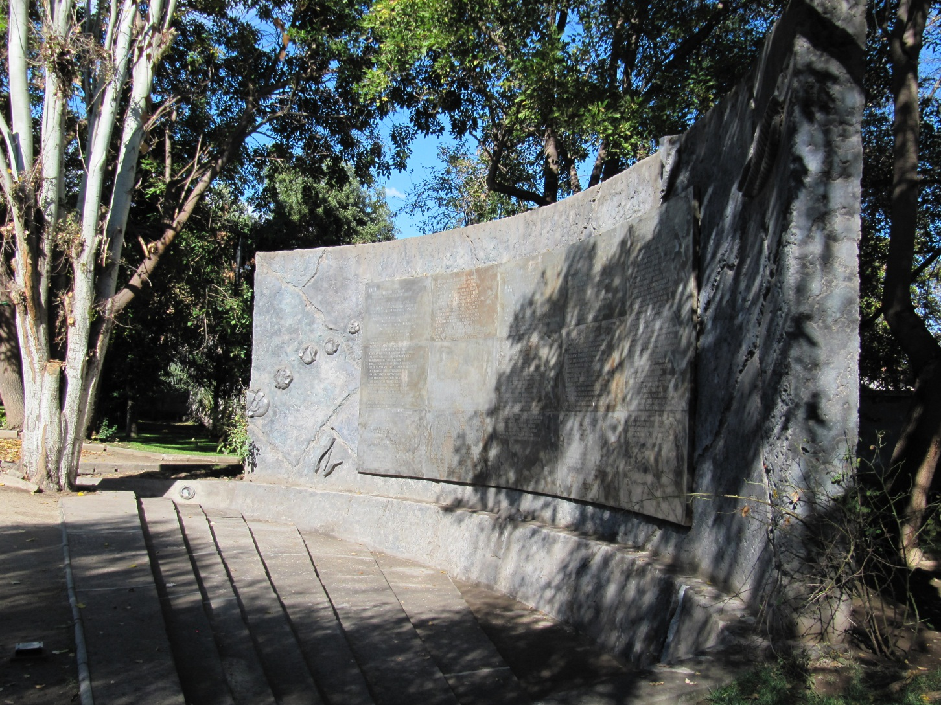
Wall of Names

Slide 22
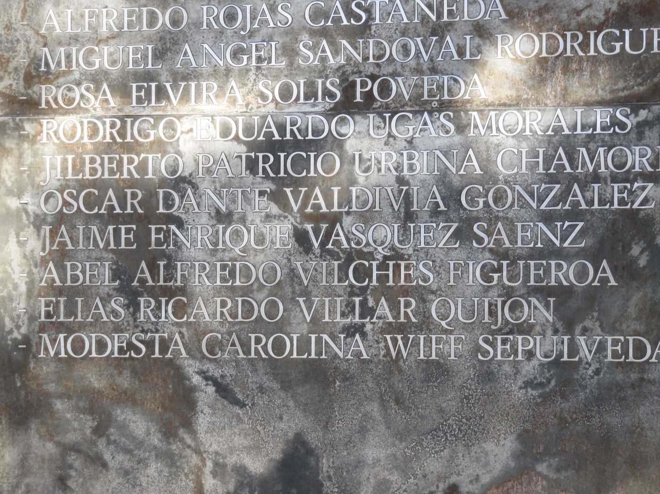
Wall of Names

Slide 23
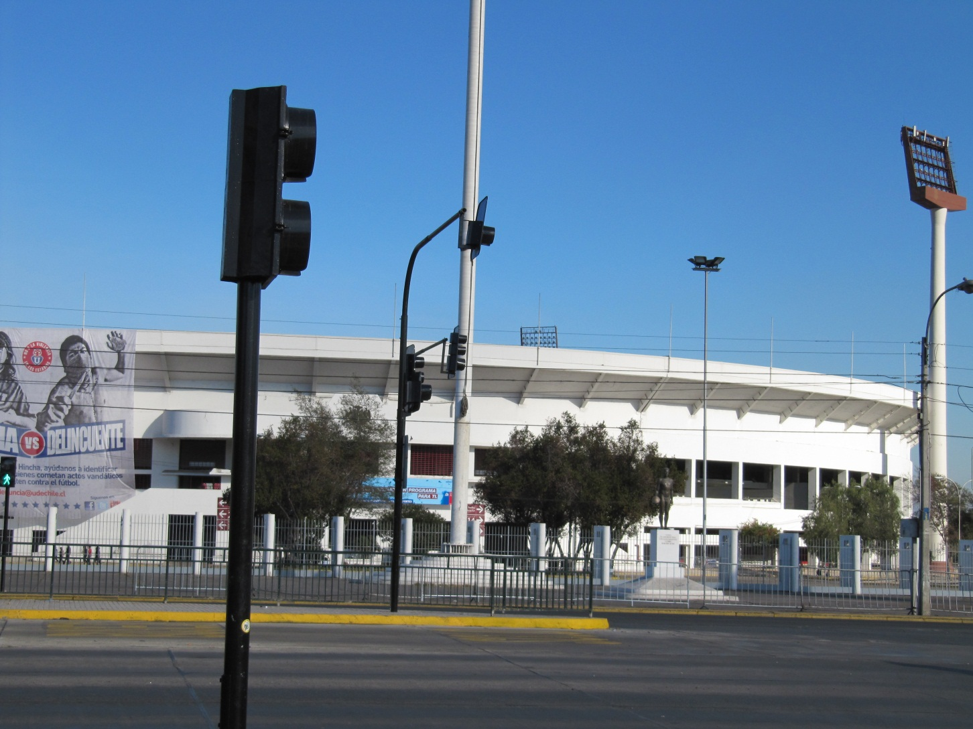
And the Soccer Stadium—under Pinochet another detention center

