Slide 1
MALVINAS MEMORIAL

Slide 2
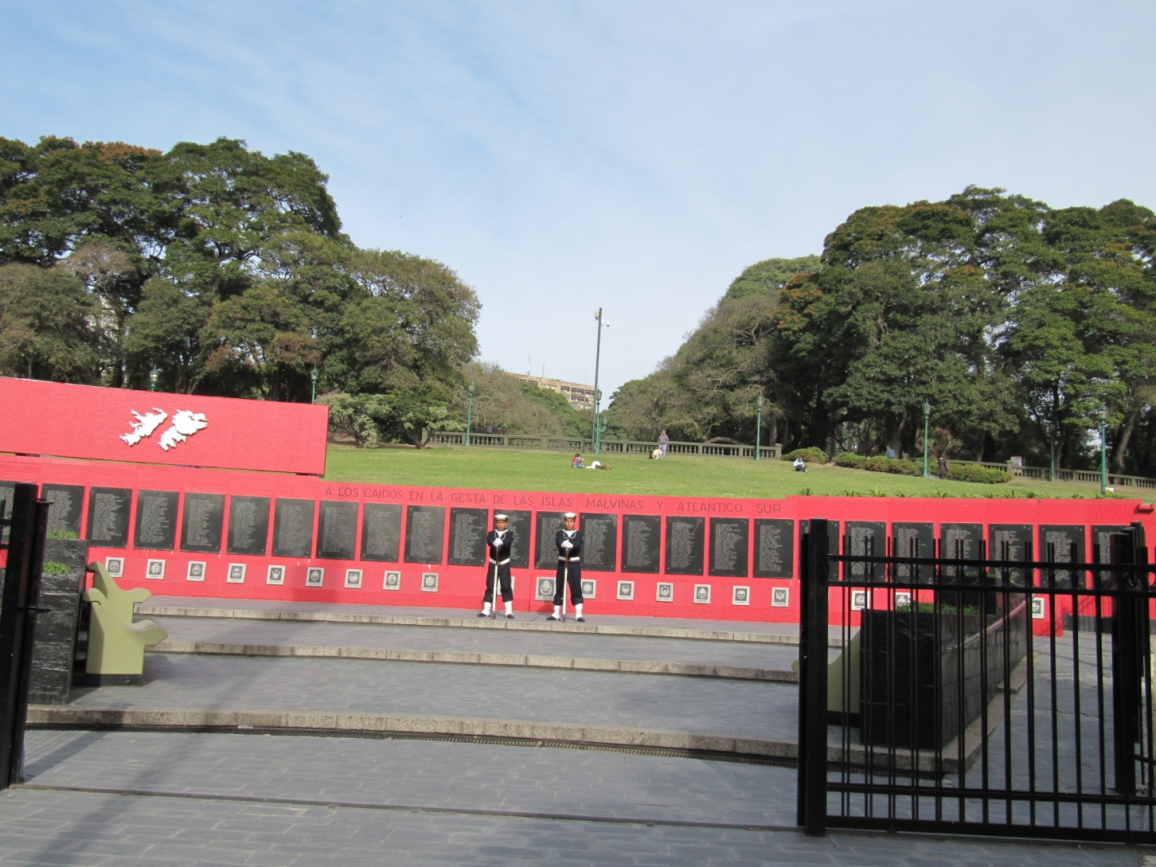

Slide 3
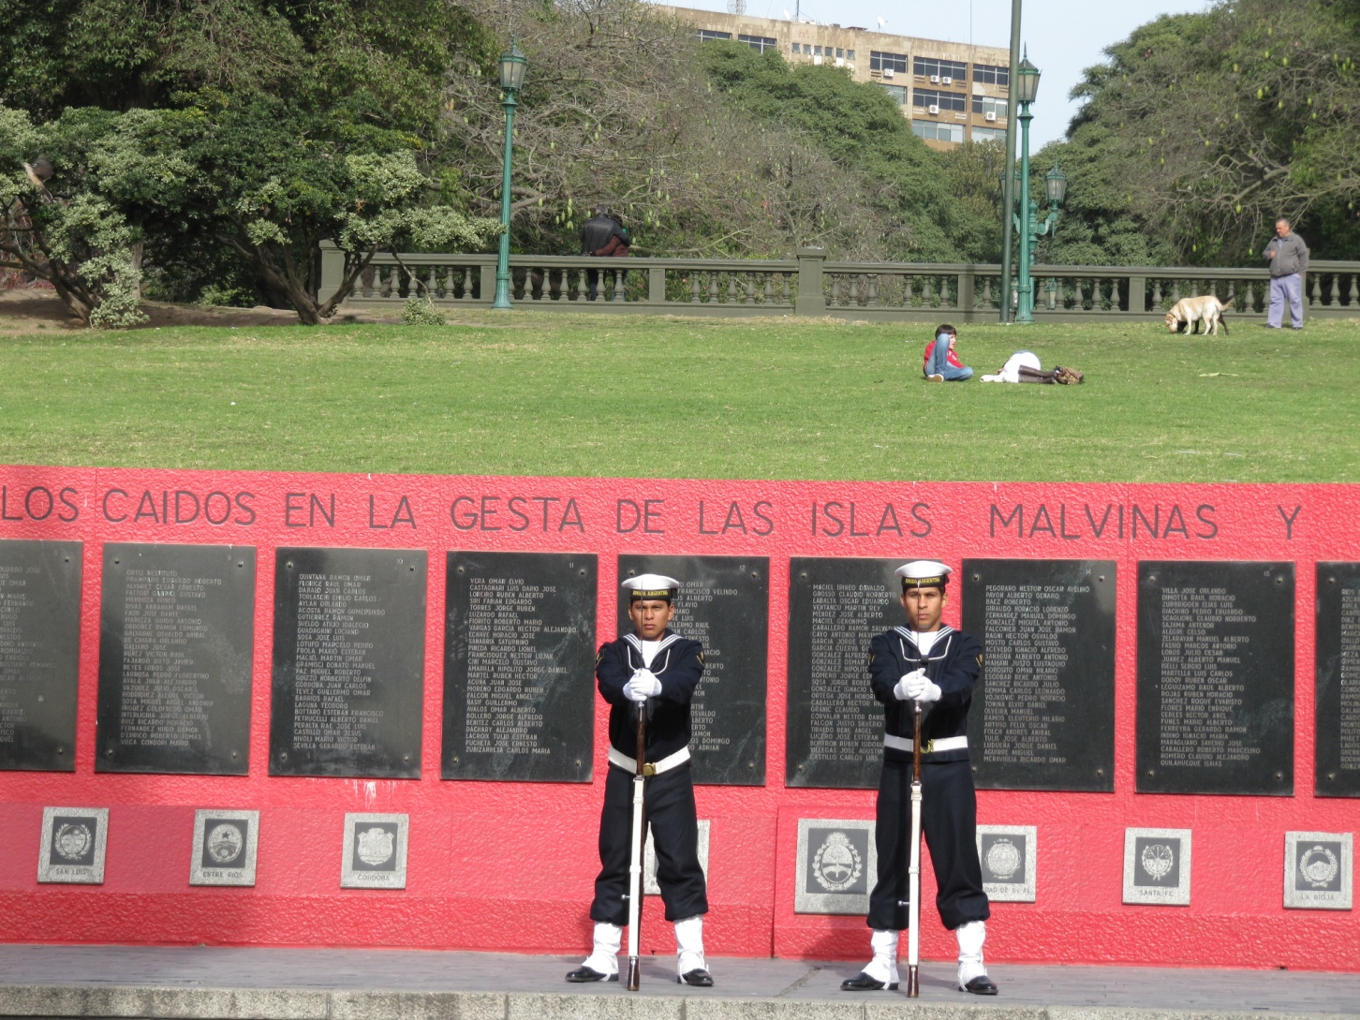

Slide 4
