Slide 1
Madres de Plaza de Mayo
ARGENTINA: The Plaza de Mayo in Buenos Aires, has been a site of protest for decades. It is here that the Mothers of Argentina’s ‘disappeared,’ begin their weekly march in the capital plaza every Thursday afternoon.
Known as the Mothers of Plaza de Mayo, they have passed down a legacy in defending human rights as they walk steadily together around the plaza to show the world that they still have not forgotten what happened to their loved ones during what has been called, ‘Argentina’s Dirty War.’
The Mothers of Plaza de Mayo have been integral to recent investigations and discoveries in what have been called ‘crimes against humanity’ in the more than 30,000 estimated missing sons and daughters who became part of ‘the disappeared’ during the reign of Argentina’s military juntas from 1975 to 1983.

Slide 2
Now after three decades, justice is finally possible in criminal courts. Thanks to the investigations carried out by victims’ families and human rights activists, Argentina’s government is now revisiting its dark past with landmark Supreme Court human rights tribunals, following the 2003 removal of amnesty laws that protected members of the military government from prosecution of human rights abuses.

Slide 3
On April 30, 1977, fourteen mothers gathered in the large plaza in front of the government building. The dictatorship prohibited people from gathering in public places, so they began walking around the pyramid in the center of the plaza. As more women joined the rounds, having visited police stations, prisons, judicial offices and churches, but finding no answers, the Mothers began to identify themselves by wearing white head scarves to symbolize the diapers of their lost and ‘disappeared’ children.

Slide 4
In addition to individual crimes, the Court is also investigating charges of ‘crimes against humanity’ committed between 1976 – 1983 at the ESMA Navy Mechanics School in Buenos Aires.
Known as the largest and most notorious torture center in Argentina during the nation’s ‘dark years,’ the ESMA Navy Mechanics School has been linked to more than 5,000 people, who’s fate has brought them to become part of ‘the disappeared.’

Slide 5
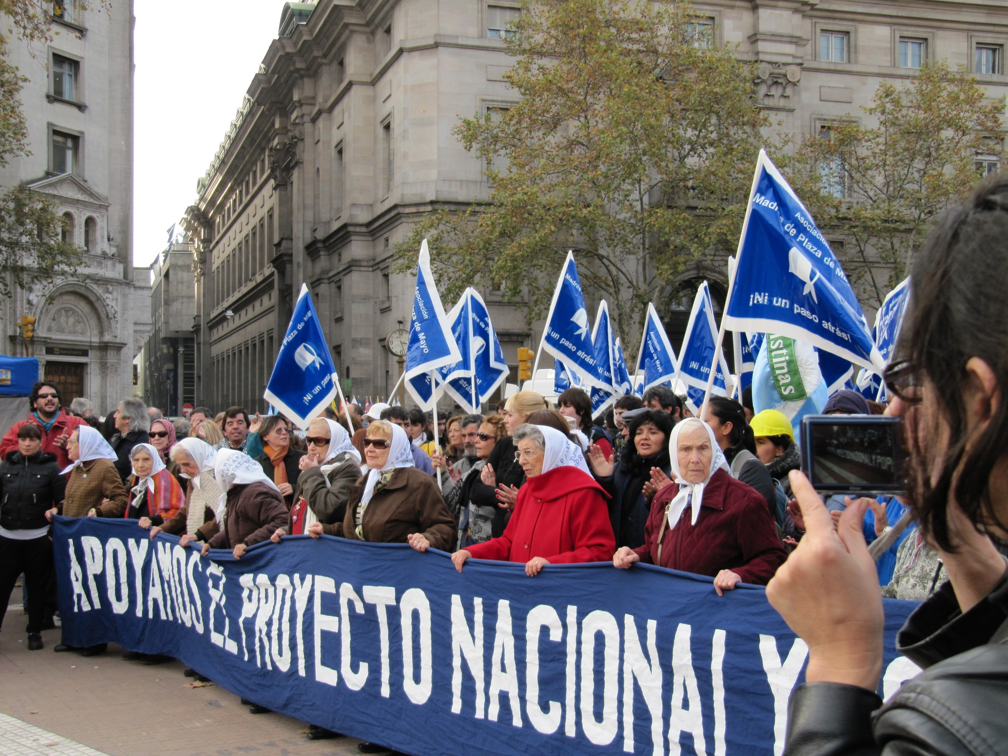

Slide 6


Slide 7
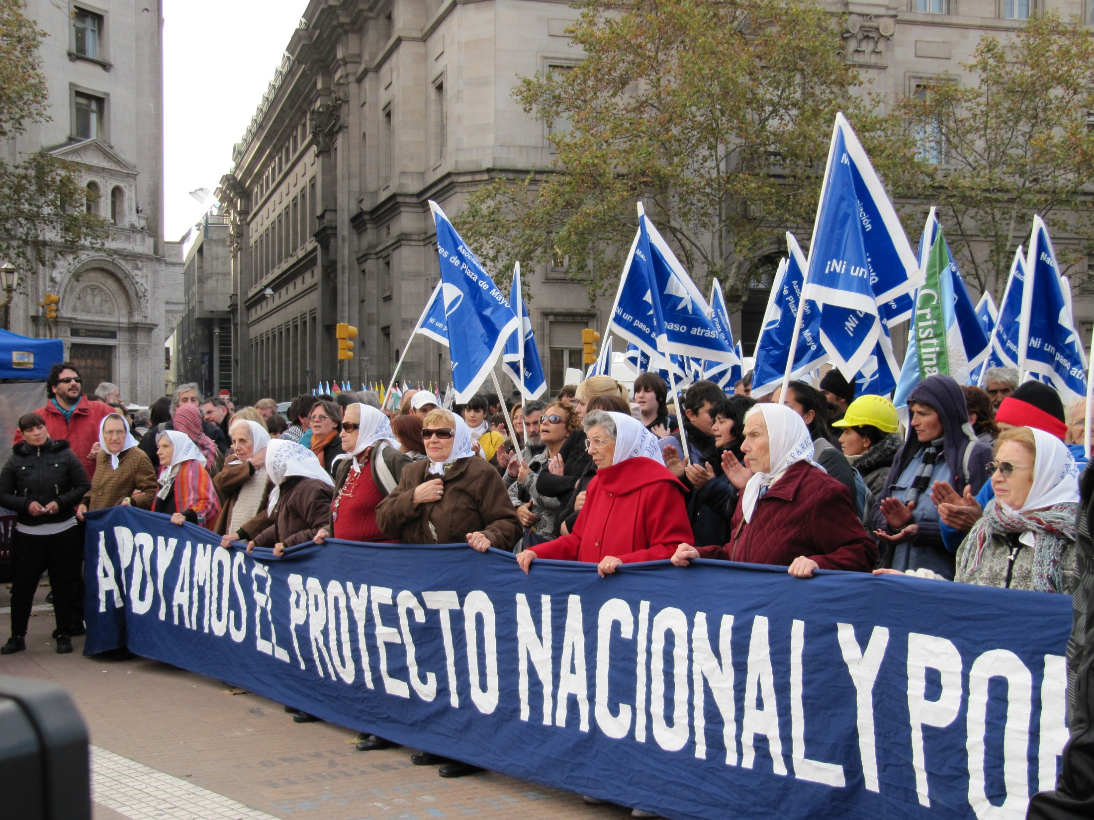

Slide 8
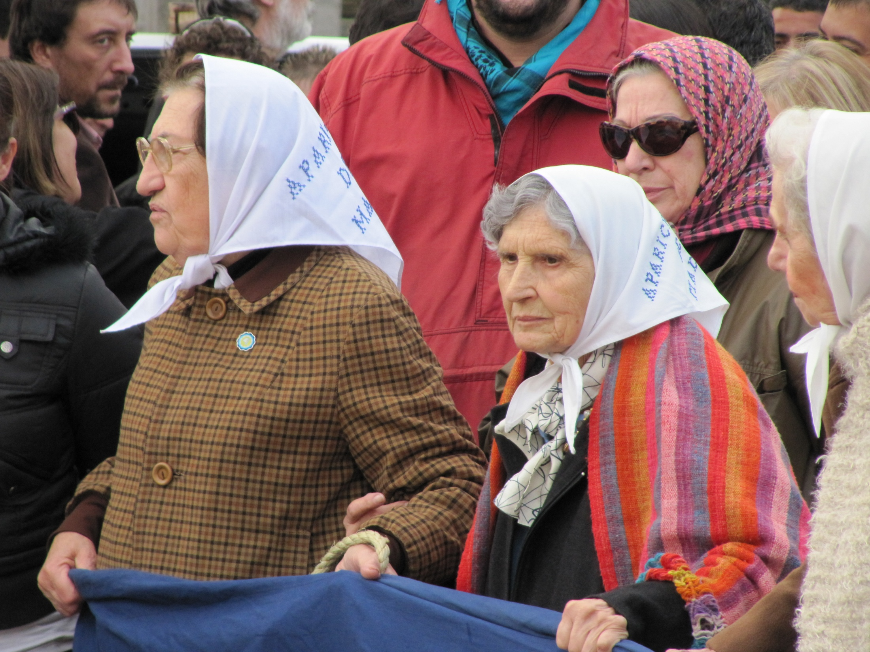

Slide 9
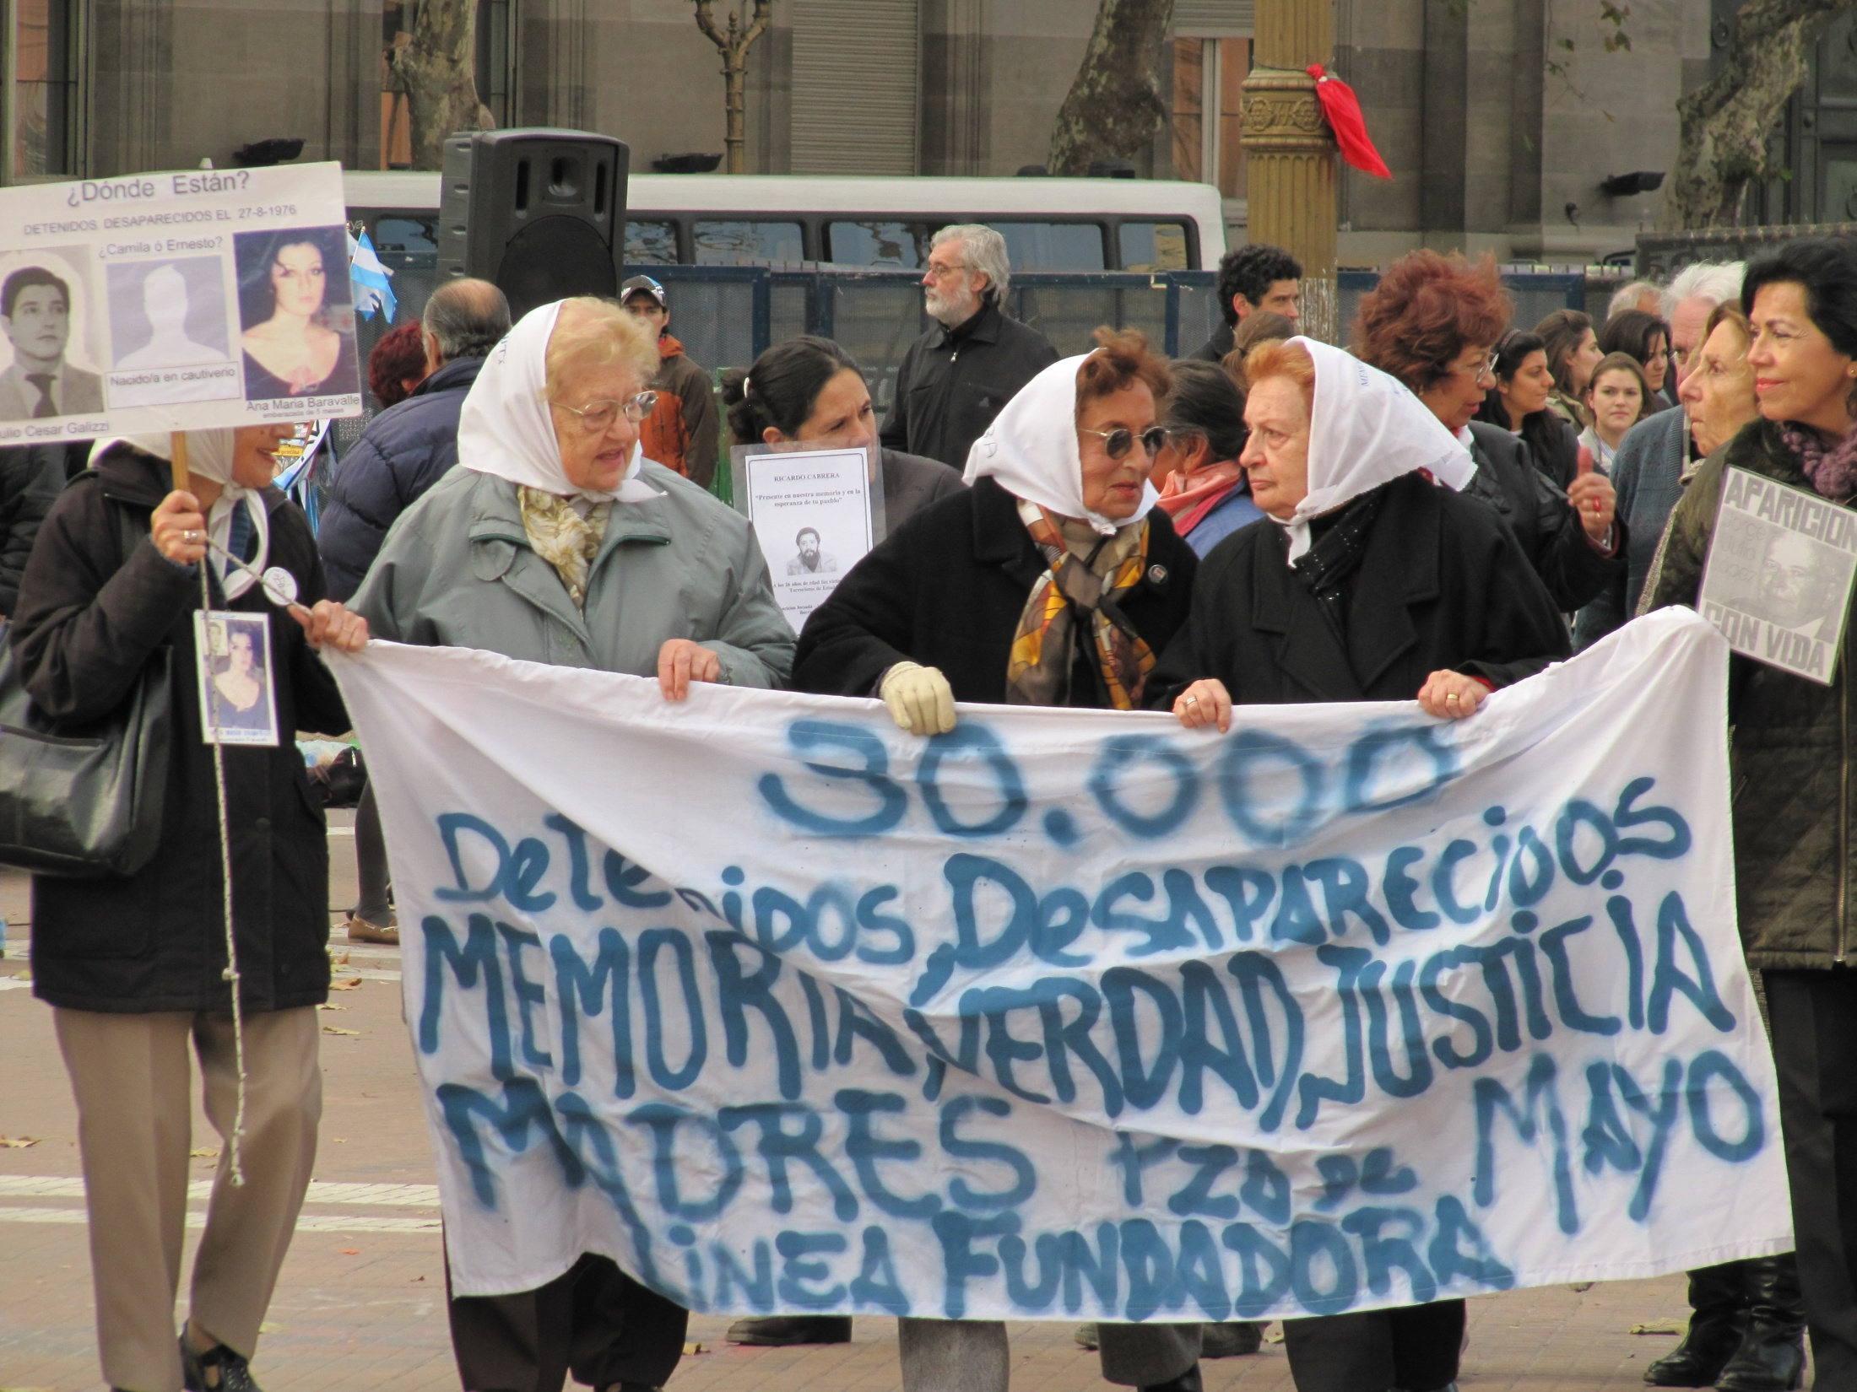

Slide 10
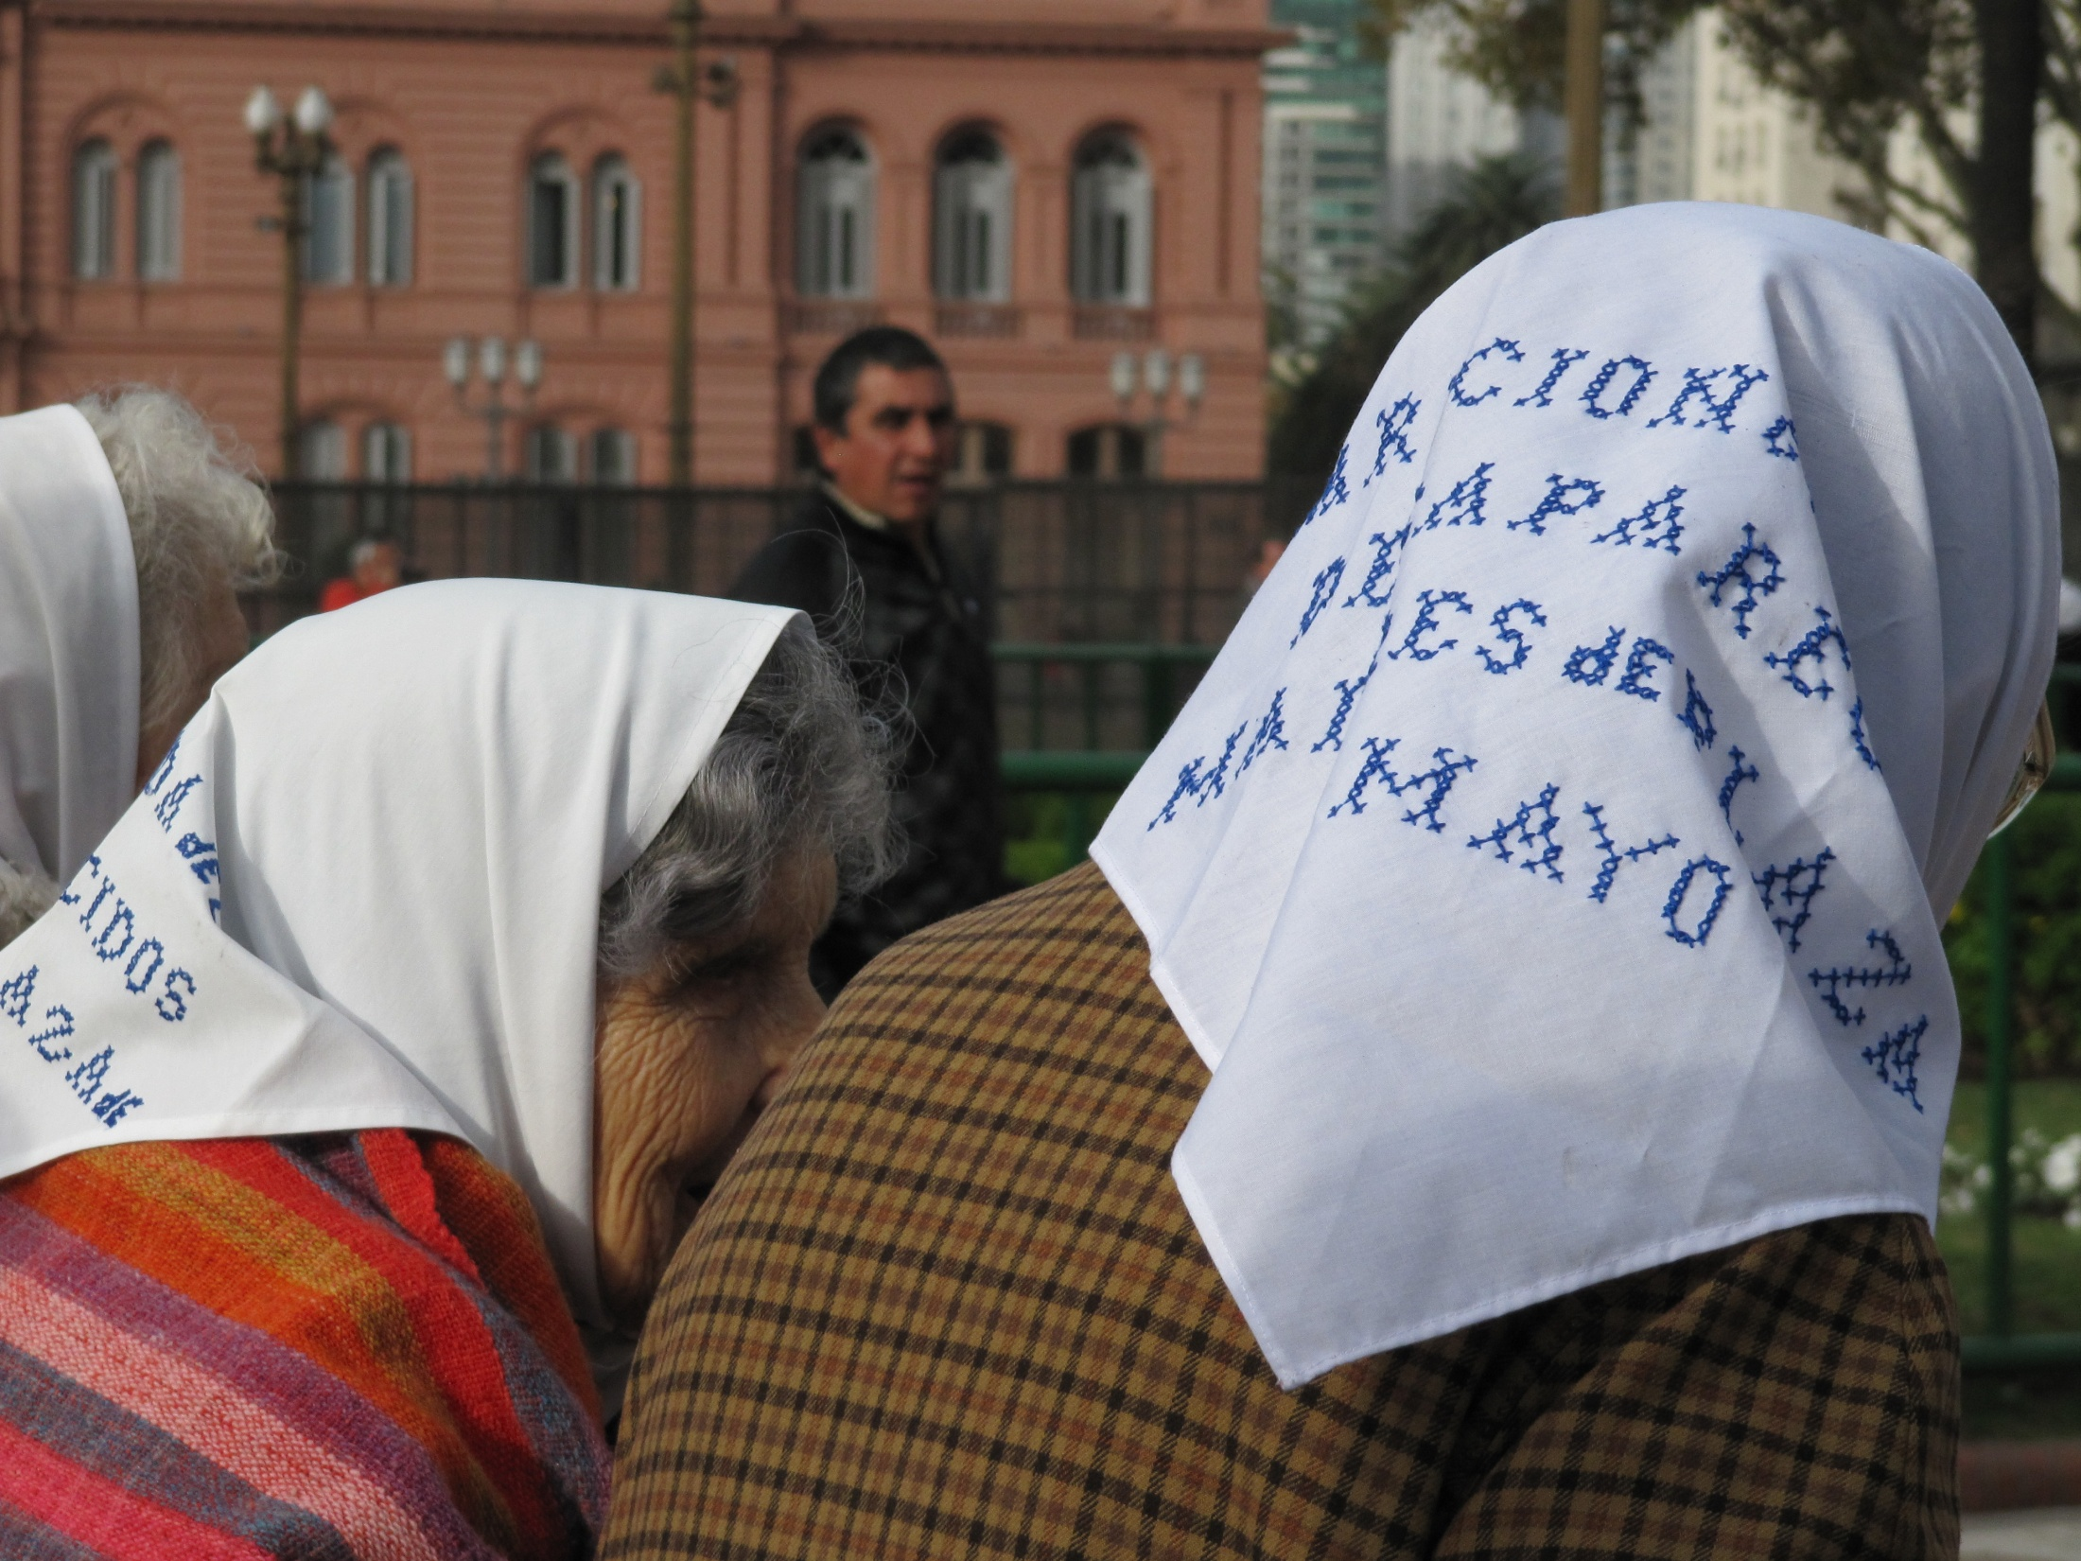

Slide 11
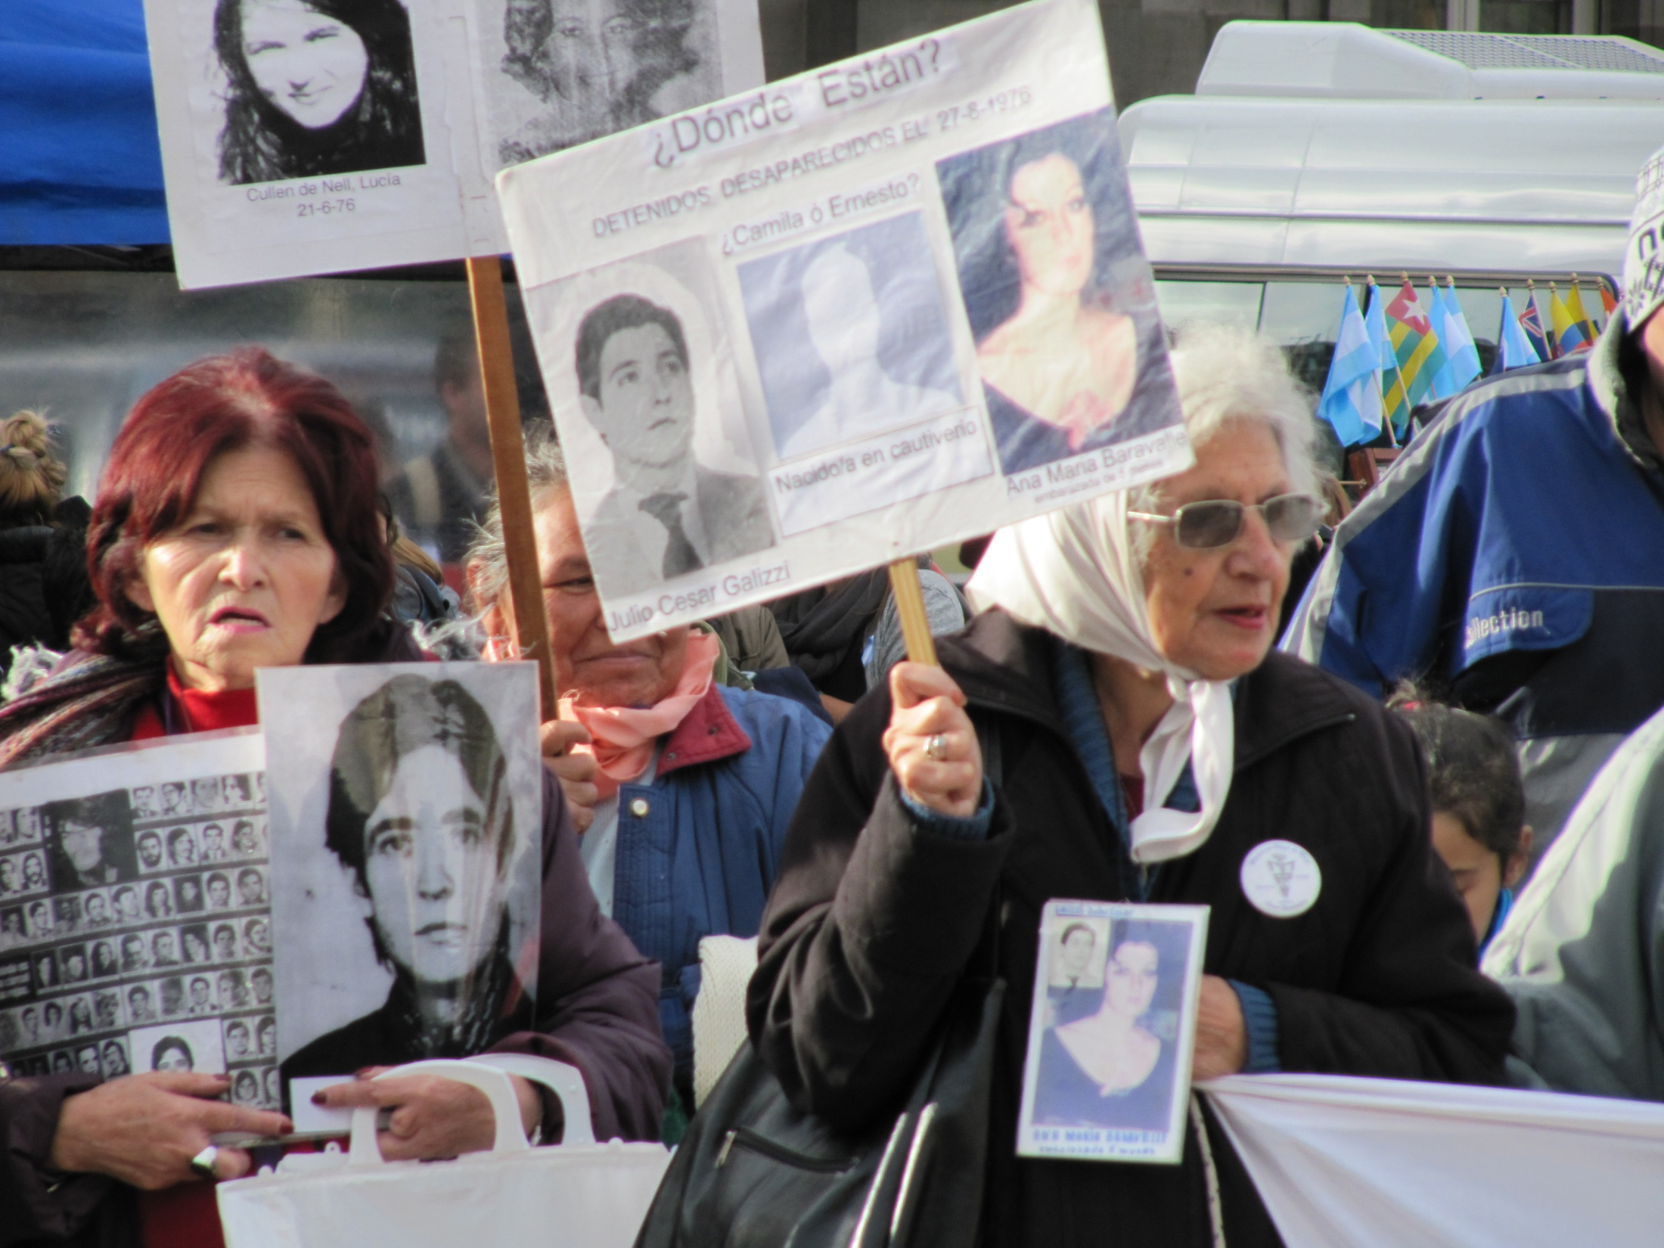

Slide 12
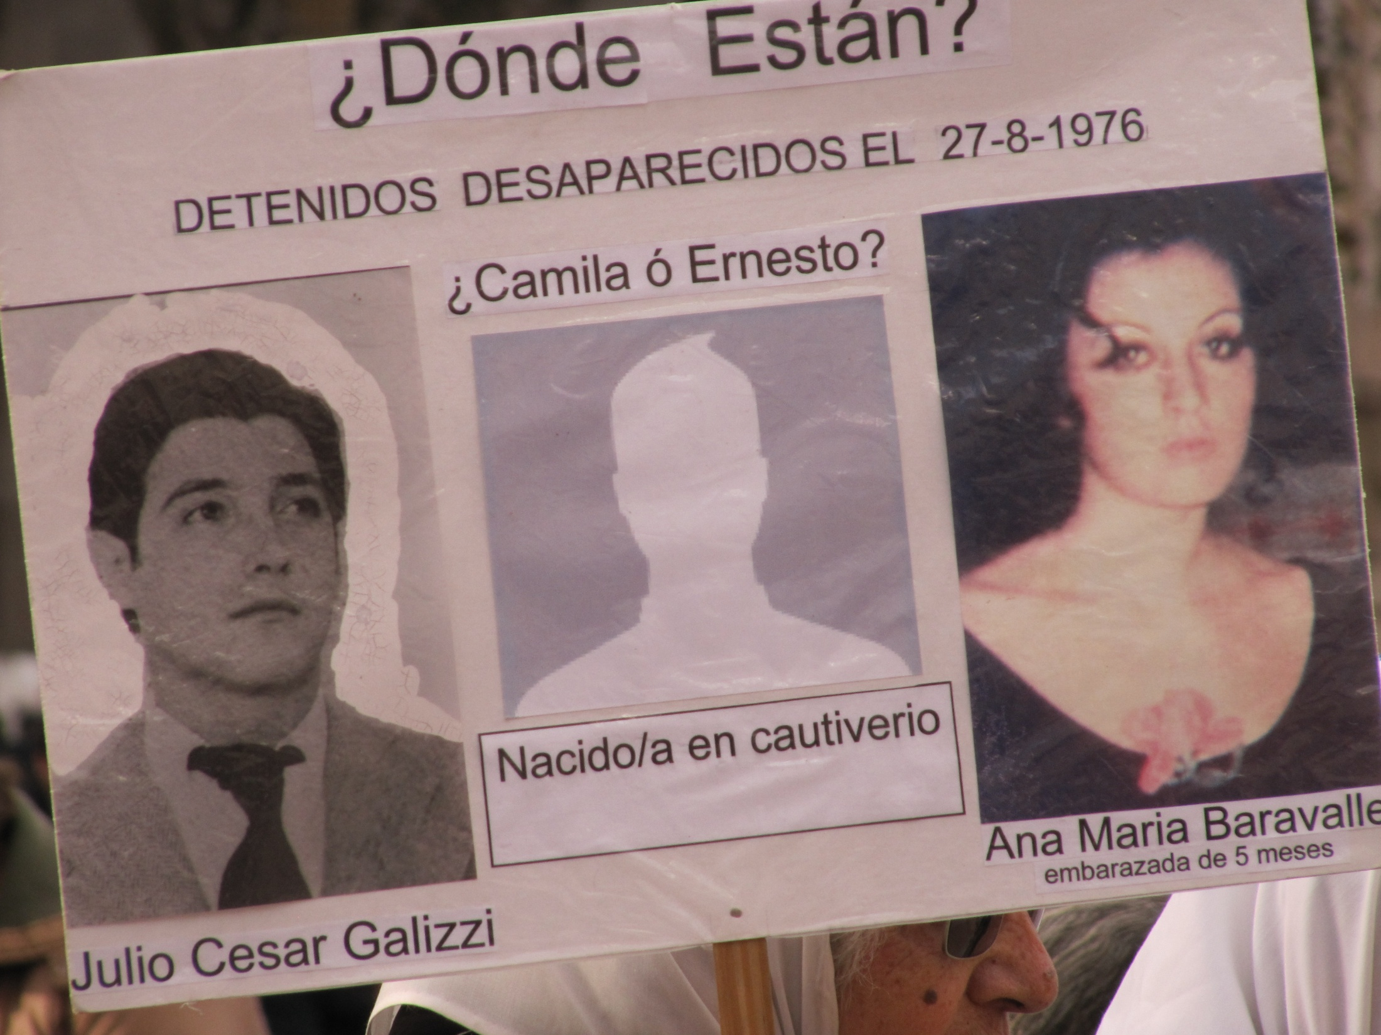

Slide 13
